Slide 1
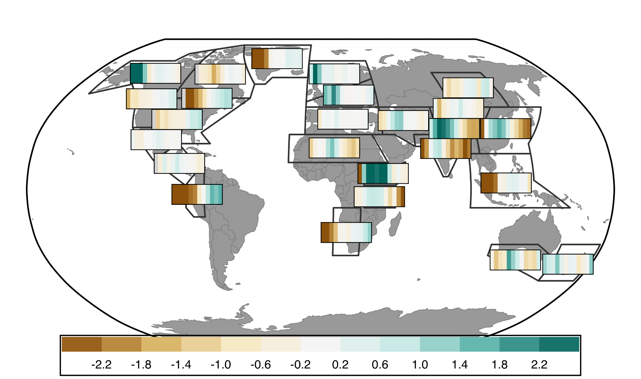
Regional Patterns in Millennial Scale Trends of Holocene Hydroclimate

Slide 2
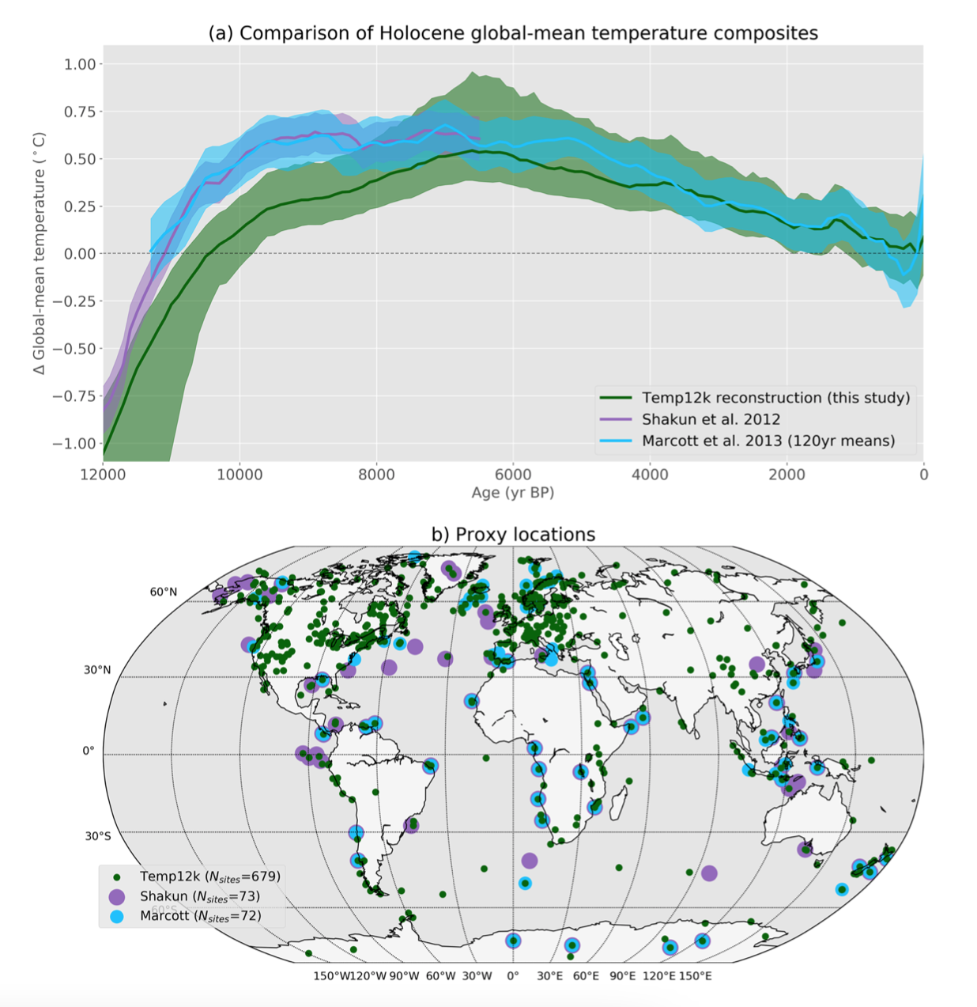
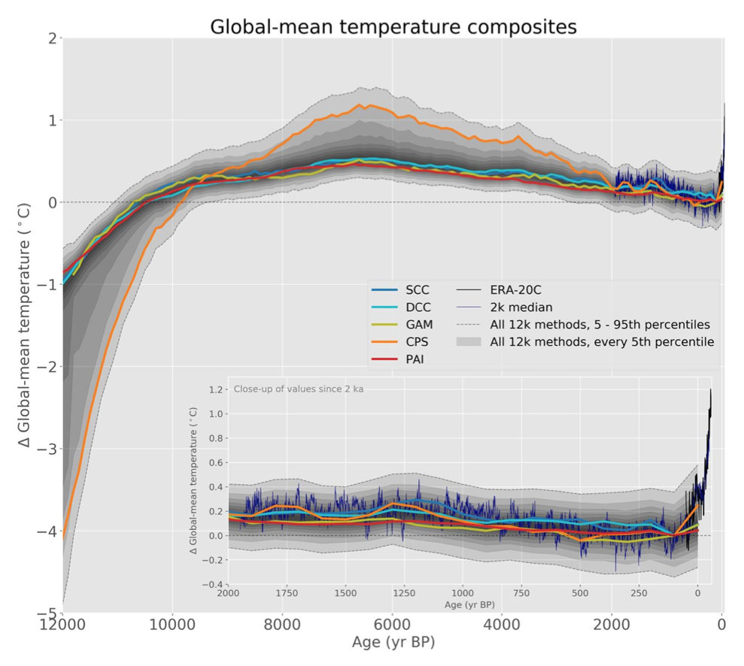
Hydroclimate research follows Temp12k

Slide 3
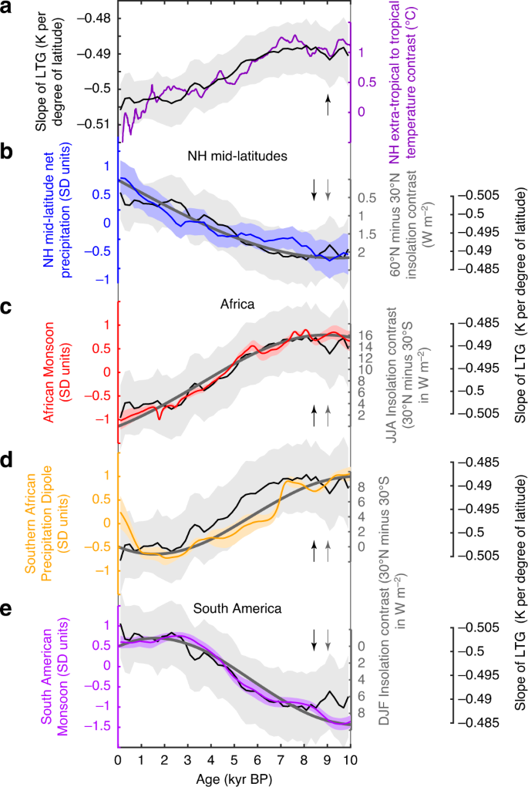
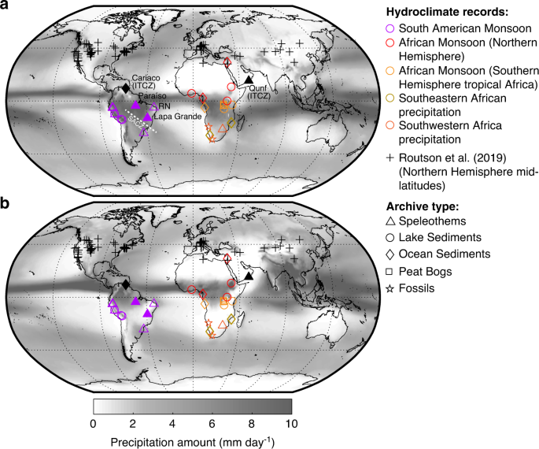
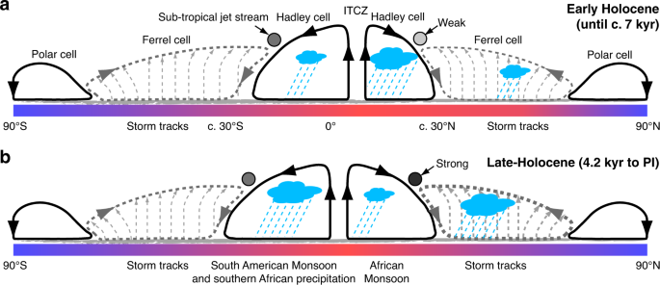
Few global multi-proxy hydroclimate reconstructions are

Slide 4
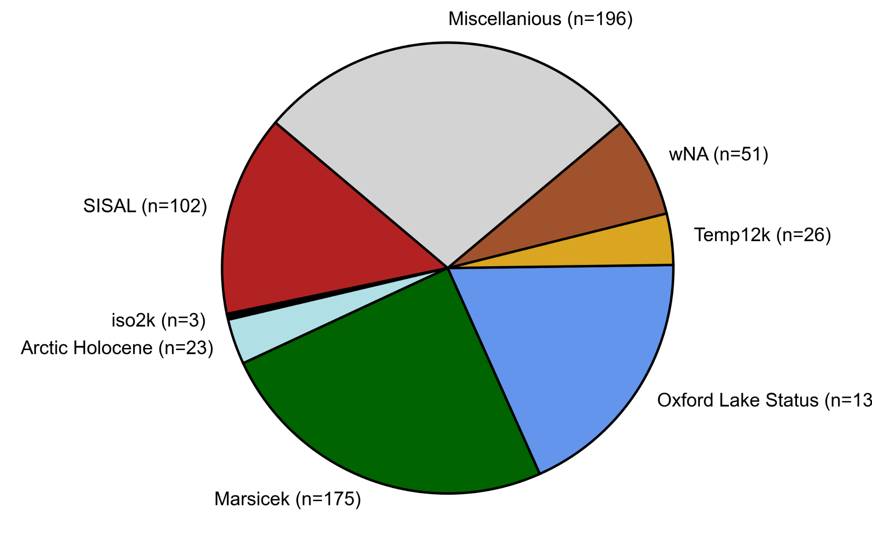
Initial work: compile a hydroclimate (P and P-E) sensitive dataset
Also Routson et al. 2018 (MidLats) can’t find info on QC sheet to search by

Slide 5
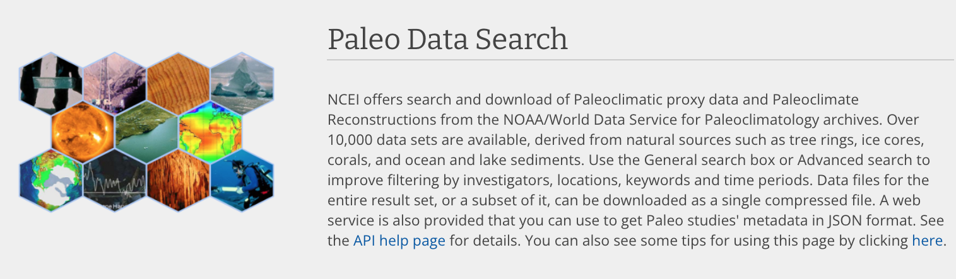


Searched public repositories for individual records
as well as previous data compilations

Slide 6


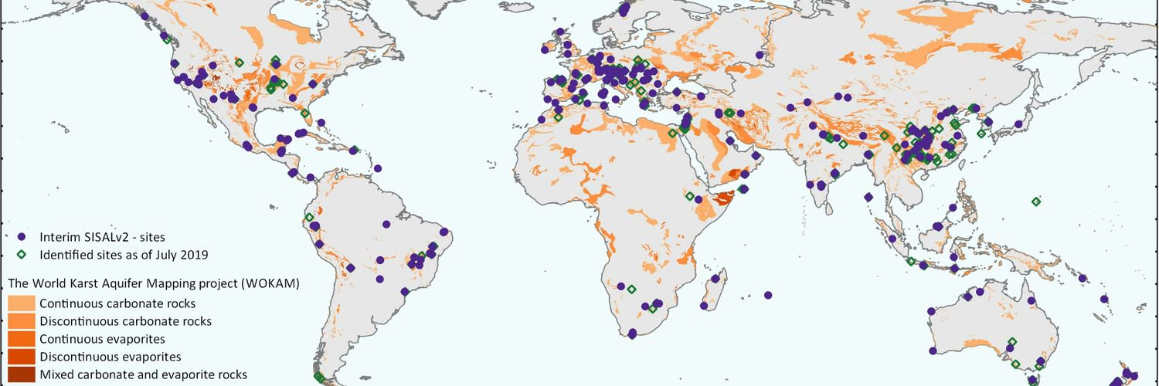
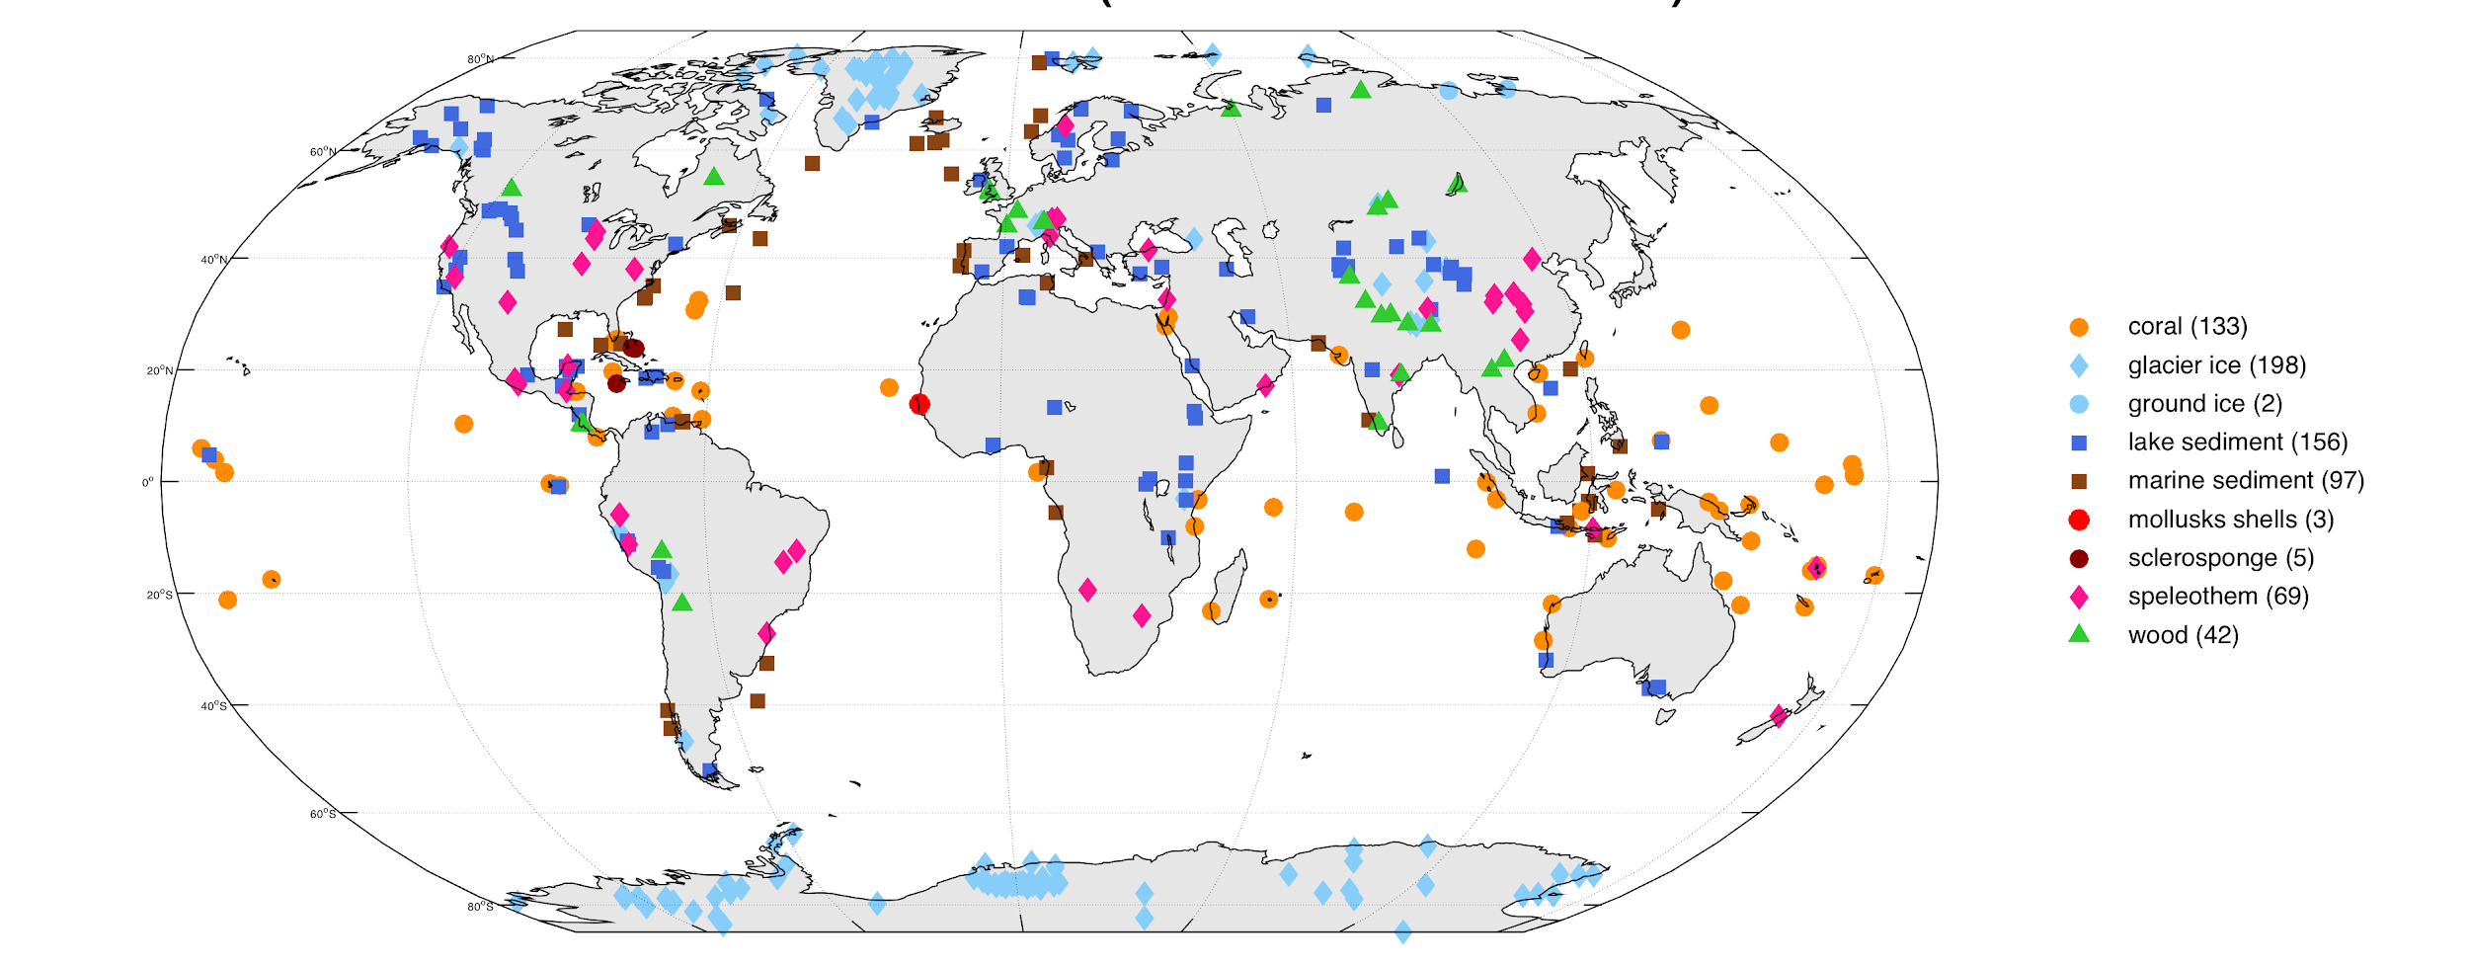
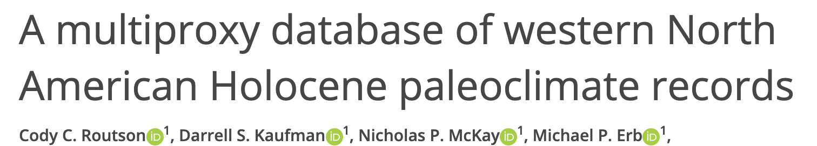
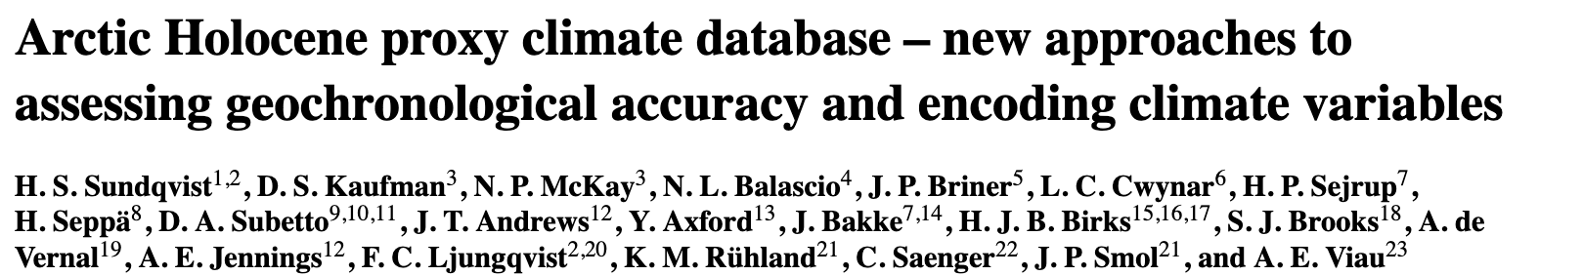
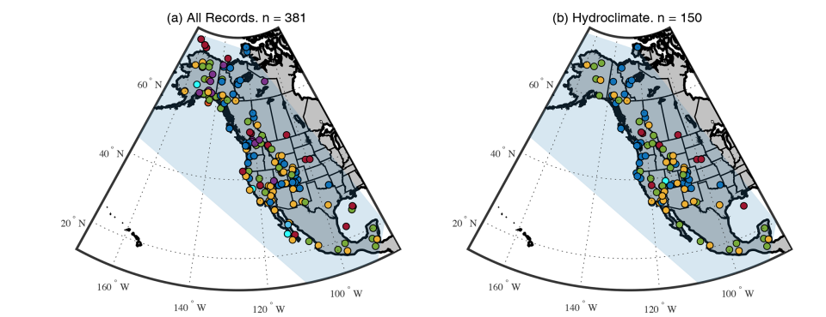
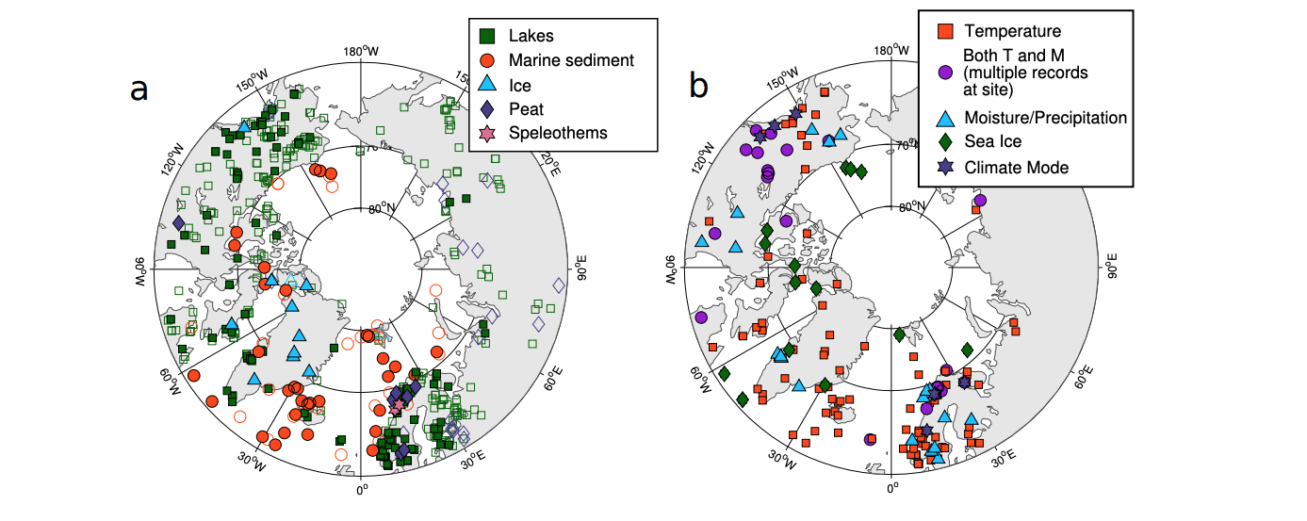

Slide 7
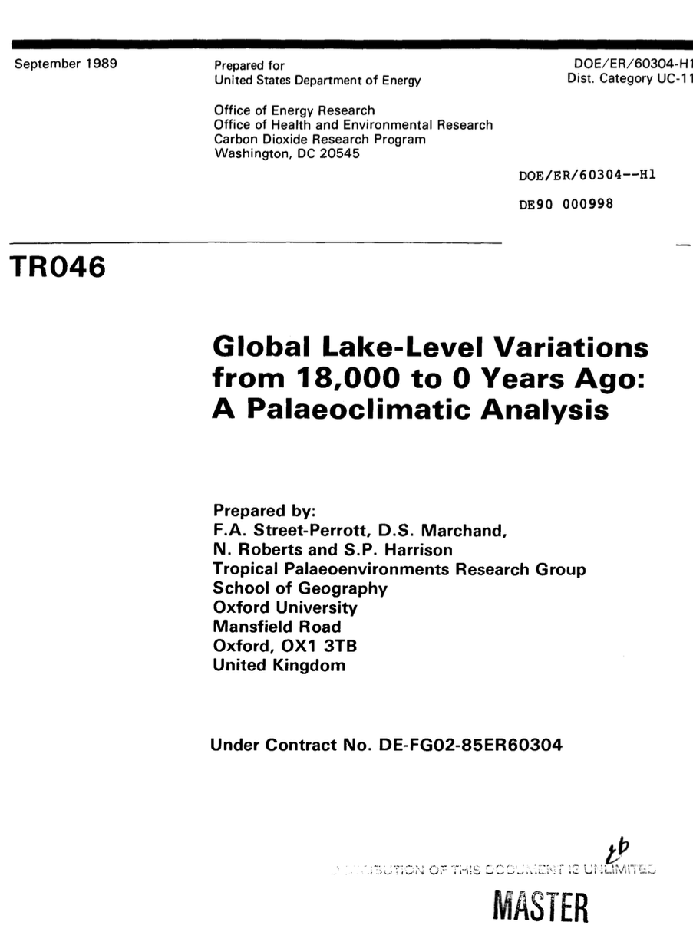
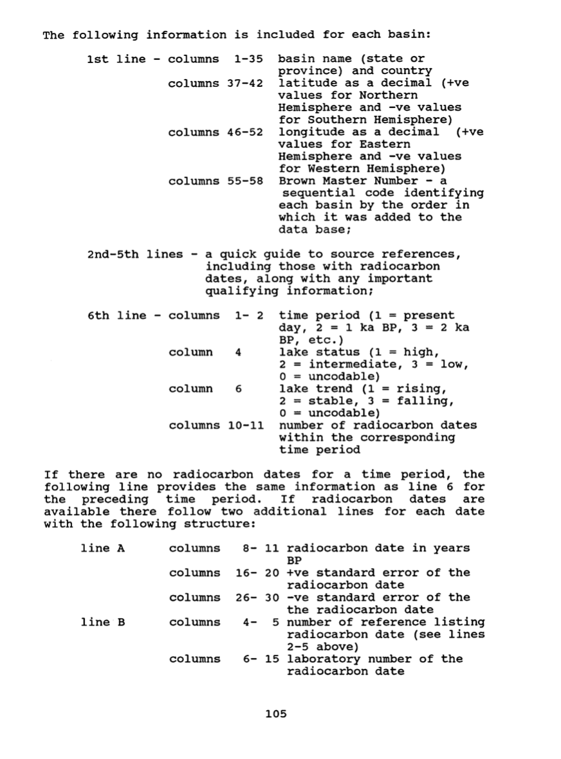
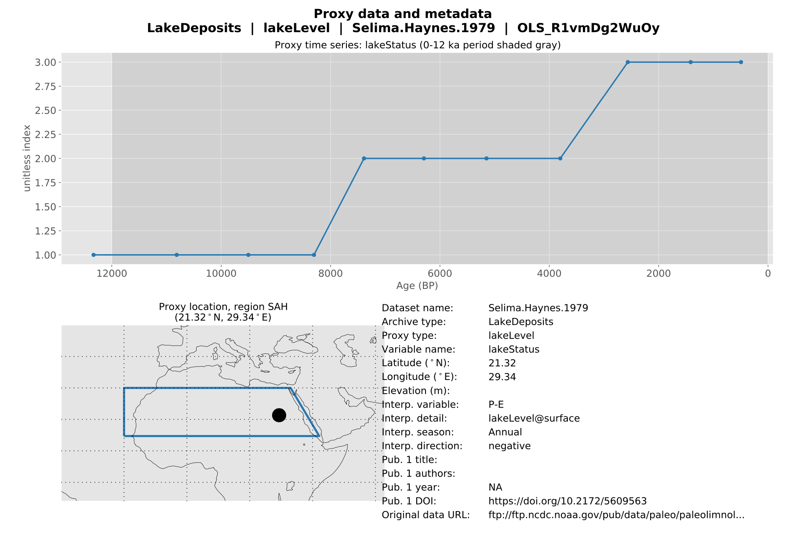

Slide 8

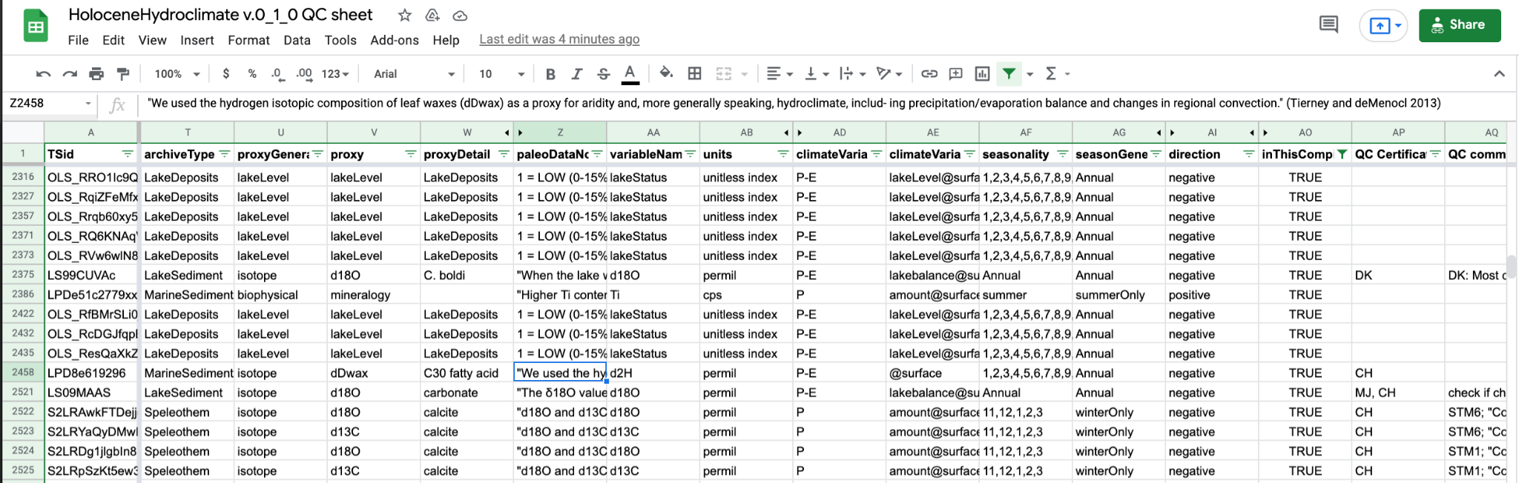
Data Management: Convert to LiPD format and add climate/seasonality metadata based on original author interpretations

Slide 9
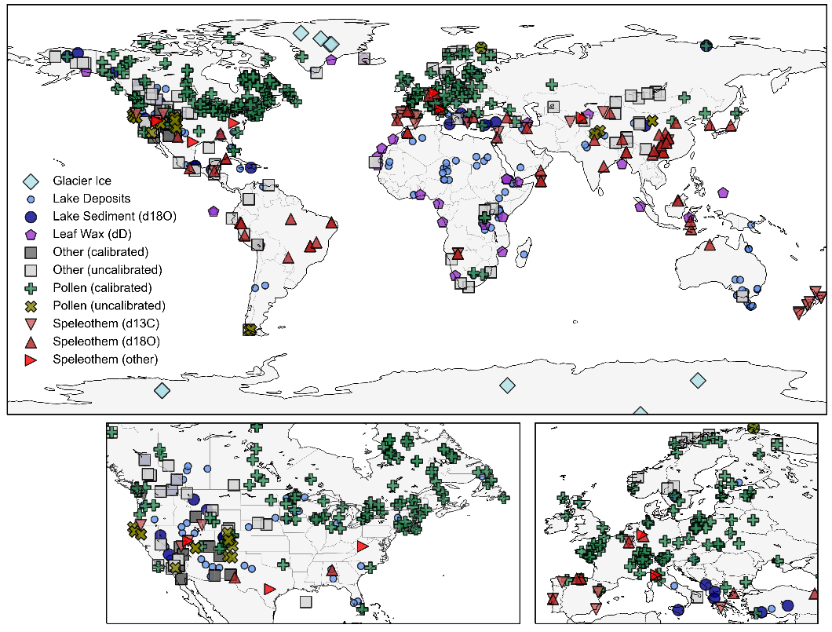

Slide 10
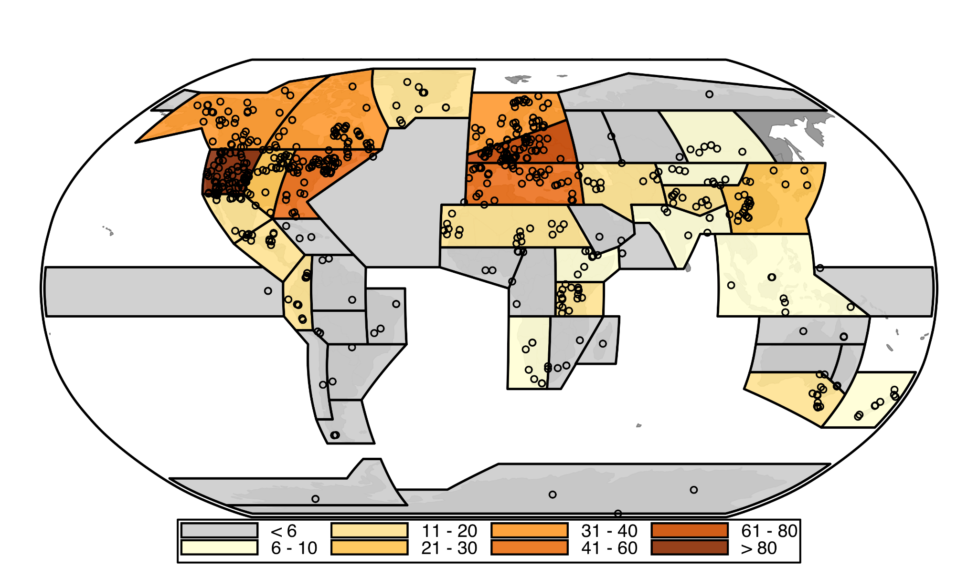
Number of proxy records within each IPCC region

Slide 11
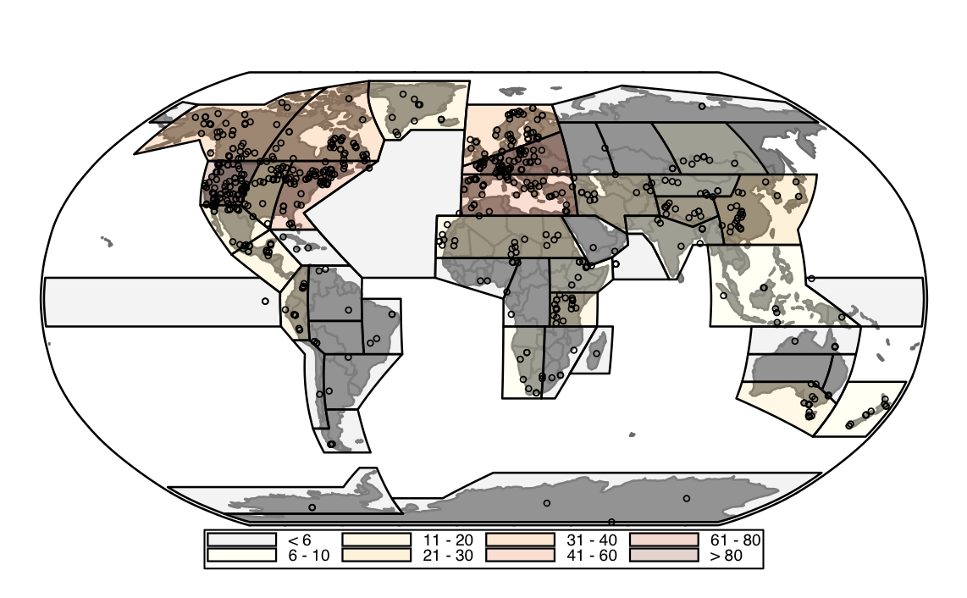

Slide 12
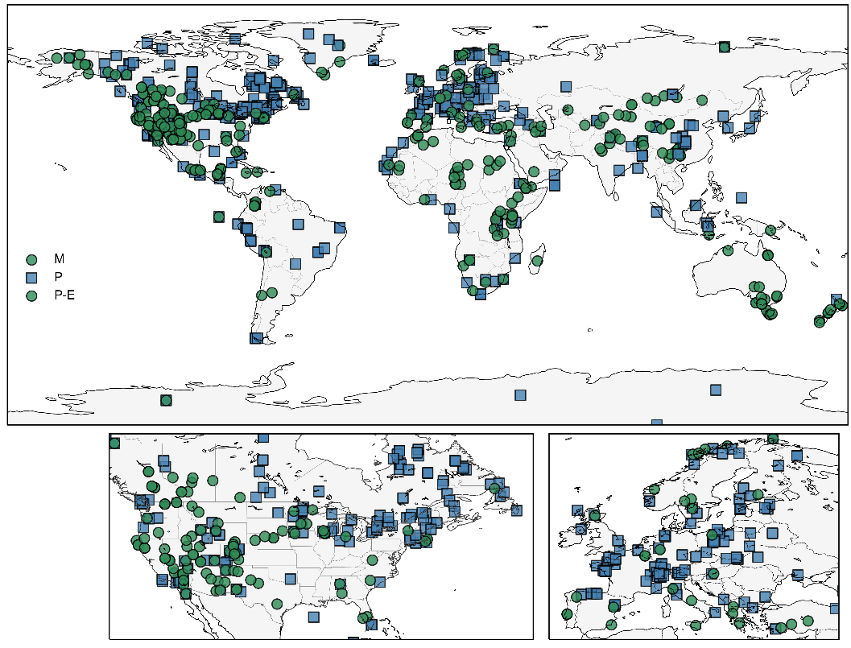

Slide 13
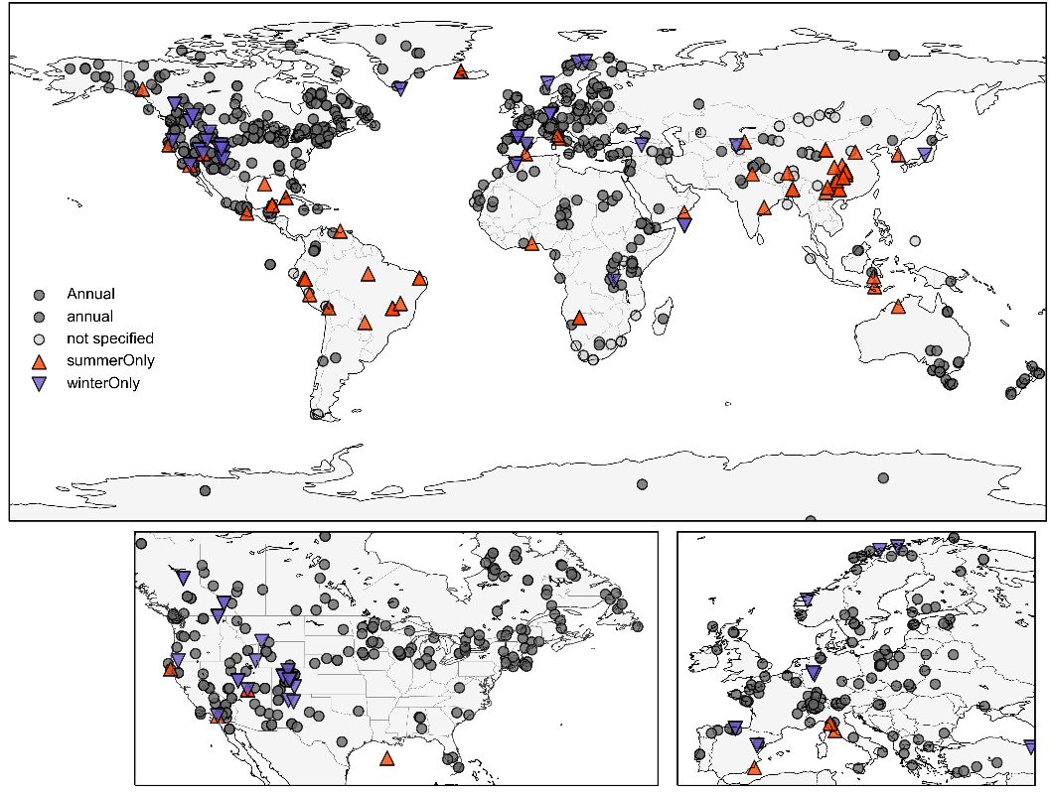

Slide 14
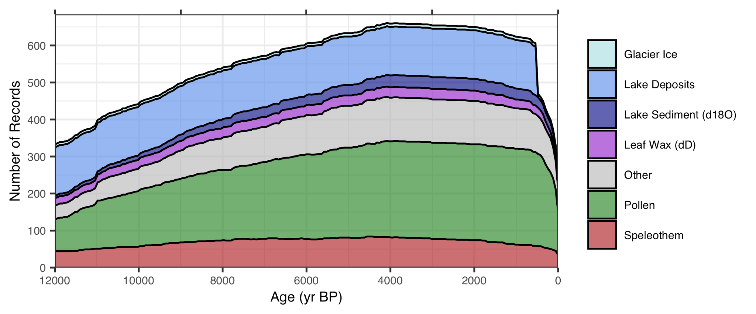
Number of Records over time

Slide 15
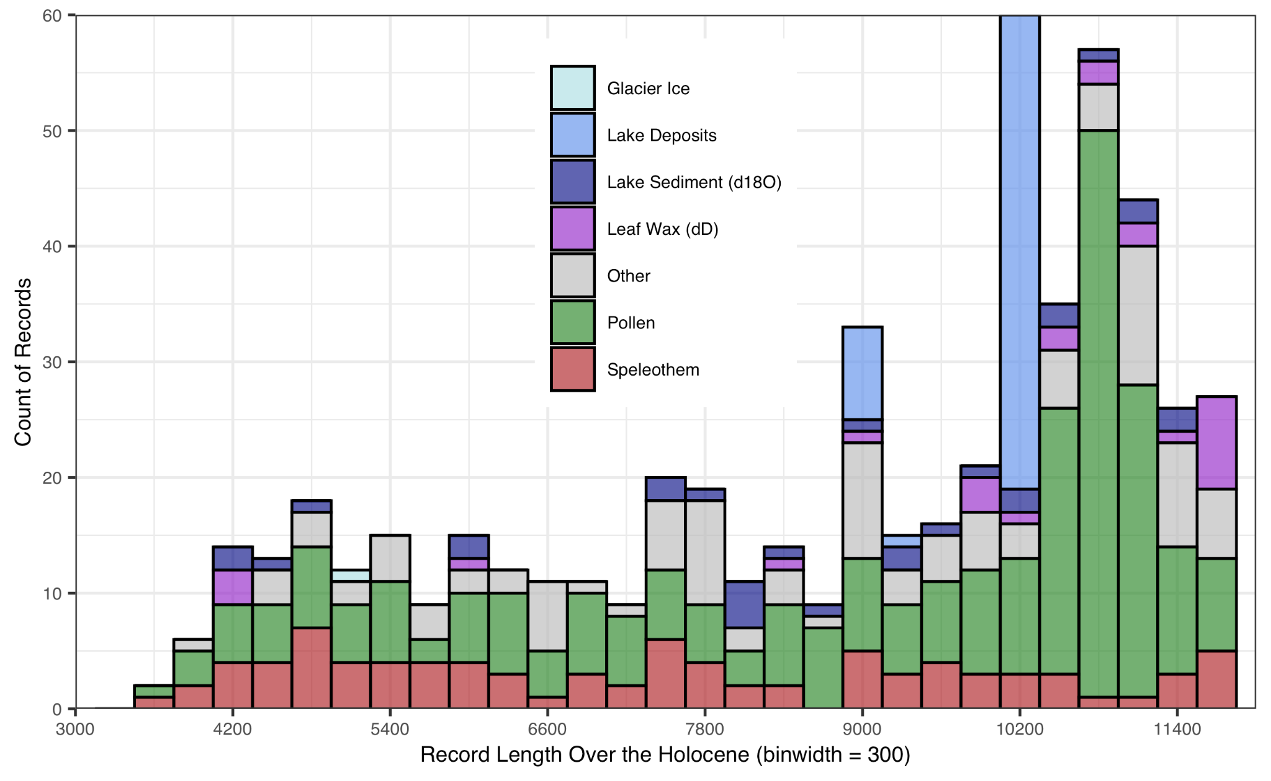
Histogram of record length
(median=10,300
mean=9,200)

Slide 16
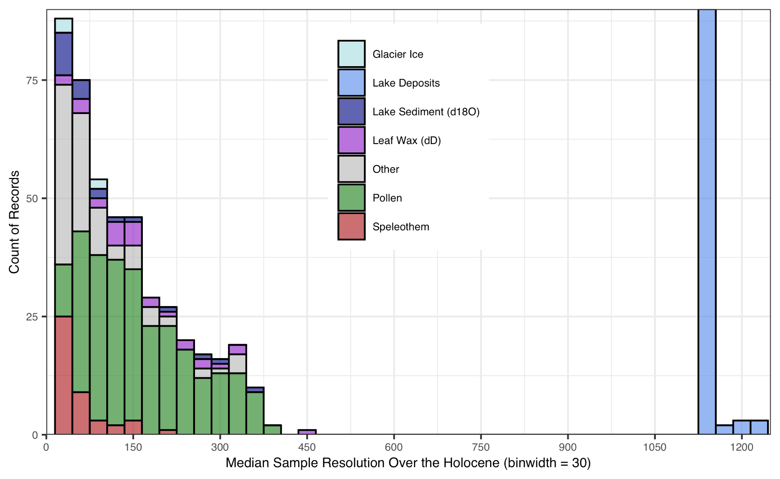
Histogram of record resolution
(median=120
mean=310)
Notes:
doesn’t count if value remains the same

Slide 17
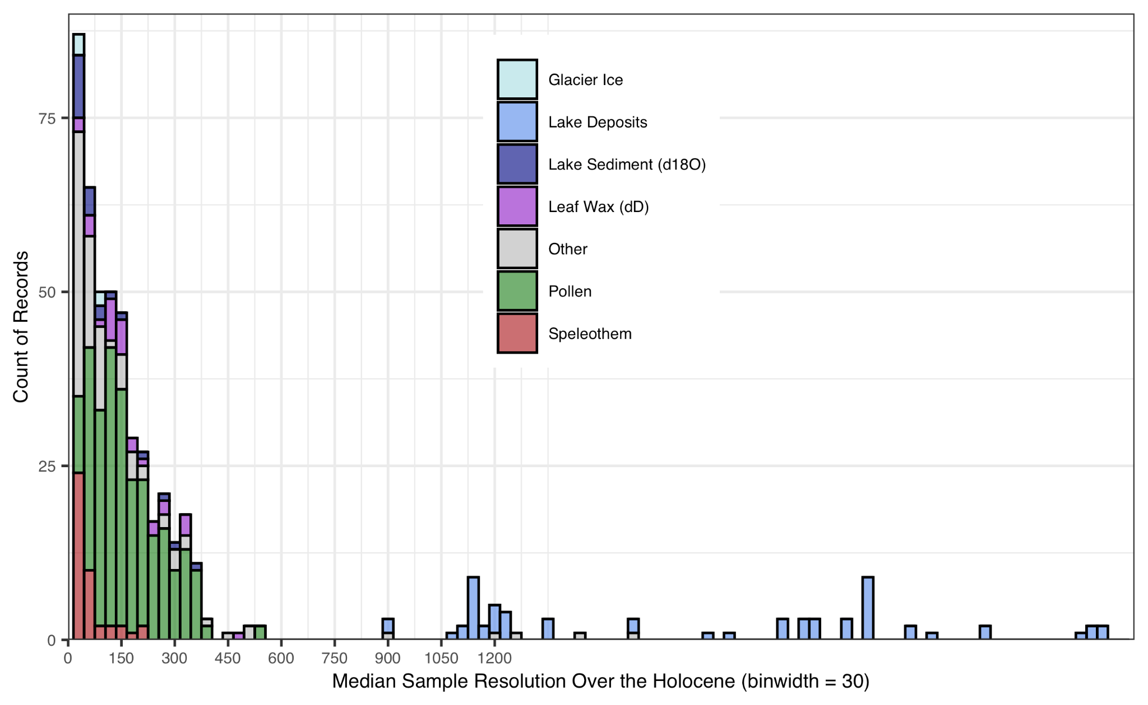
Histogram of record resolution
(median=120
mean=484)
Notes:
doesn’t count if value remains the same

Slide 18
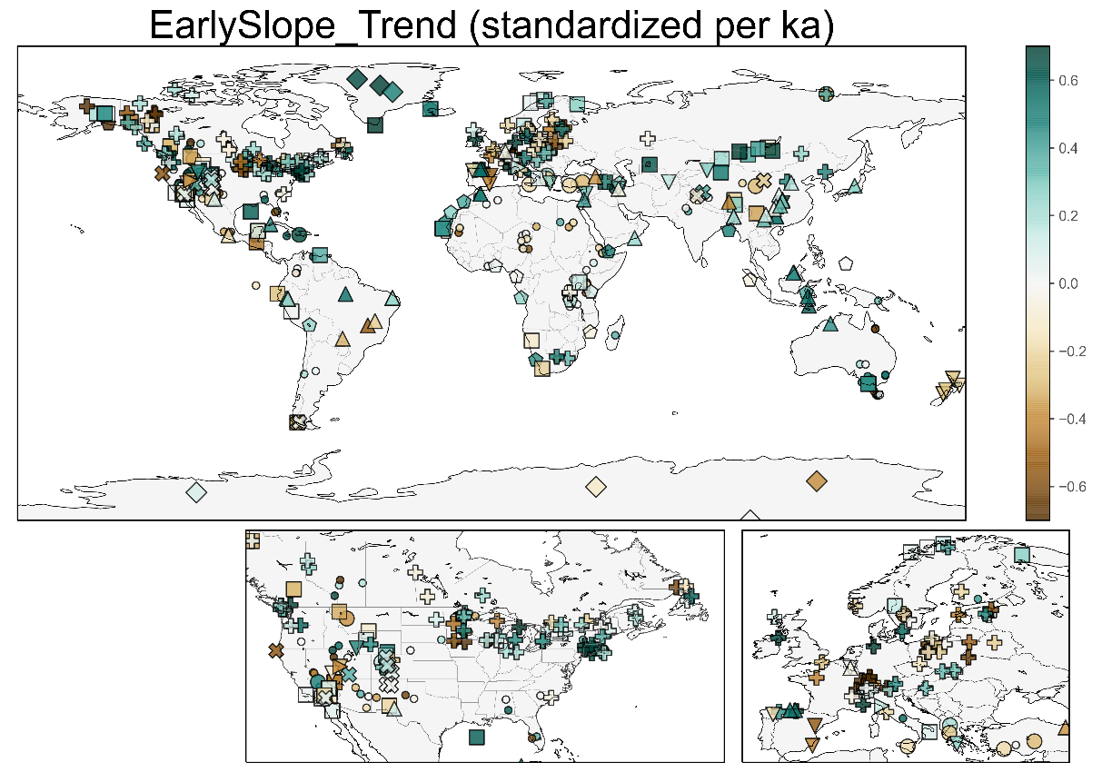

Slide 19
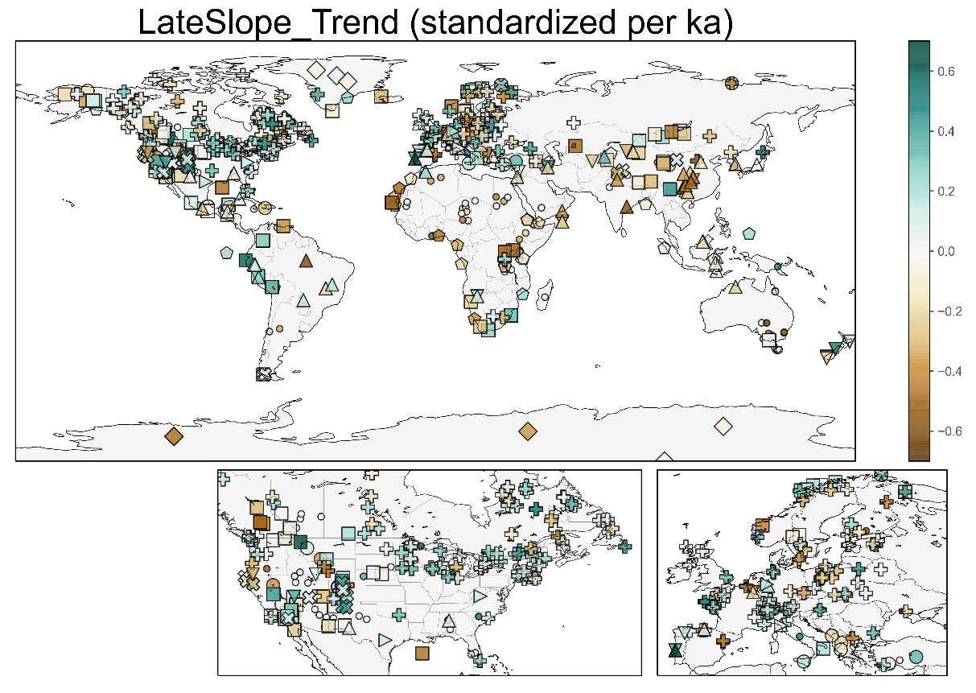

Slide 20
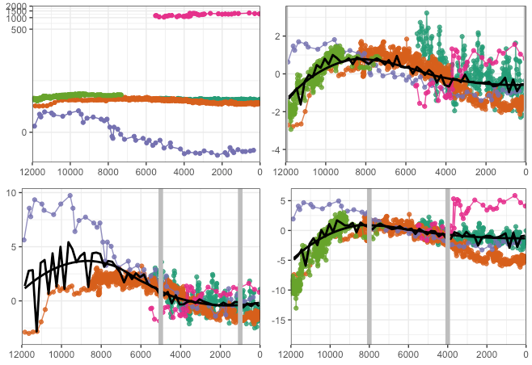
Typical composite method using z scores
Data on different values scales (precip mm/a vs d18O)
Subtract mean and divide by standard deviation

Slide 21
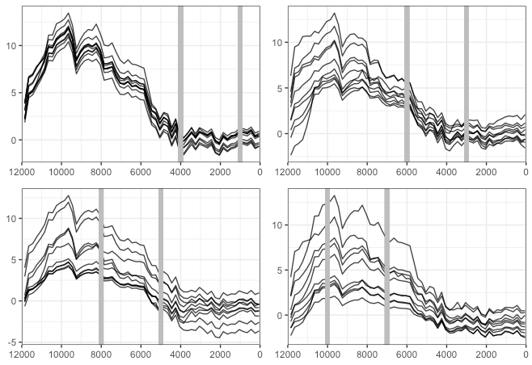
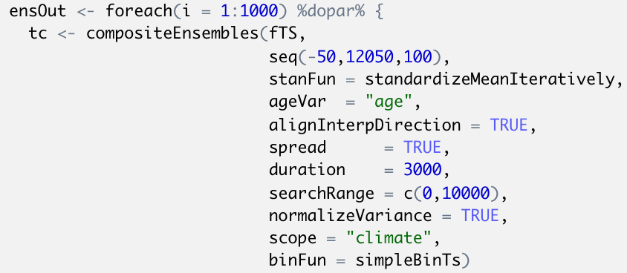
Composite R Code

Slide 22
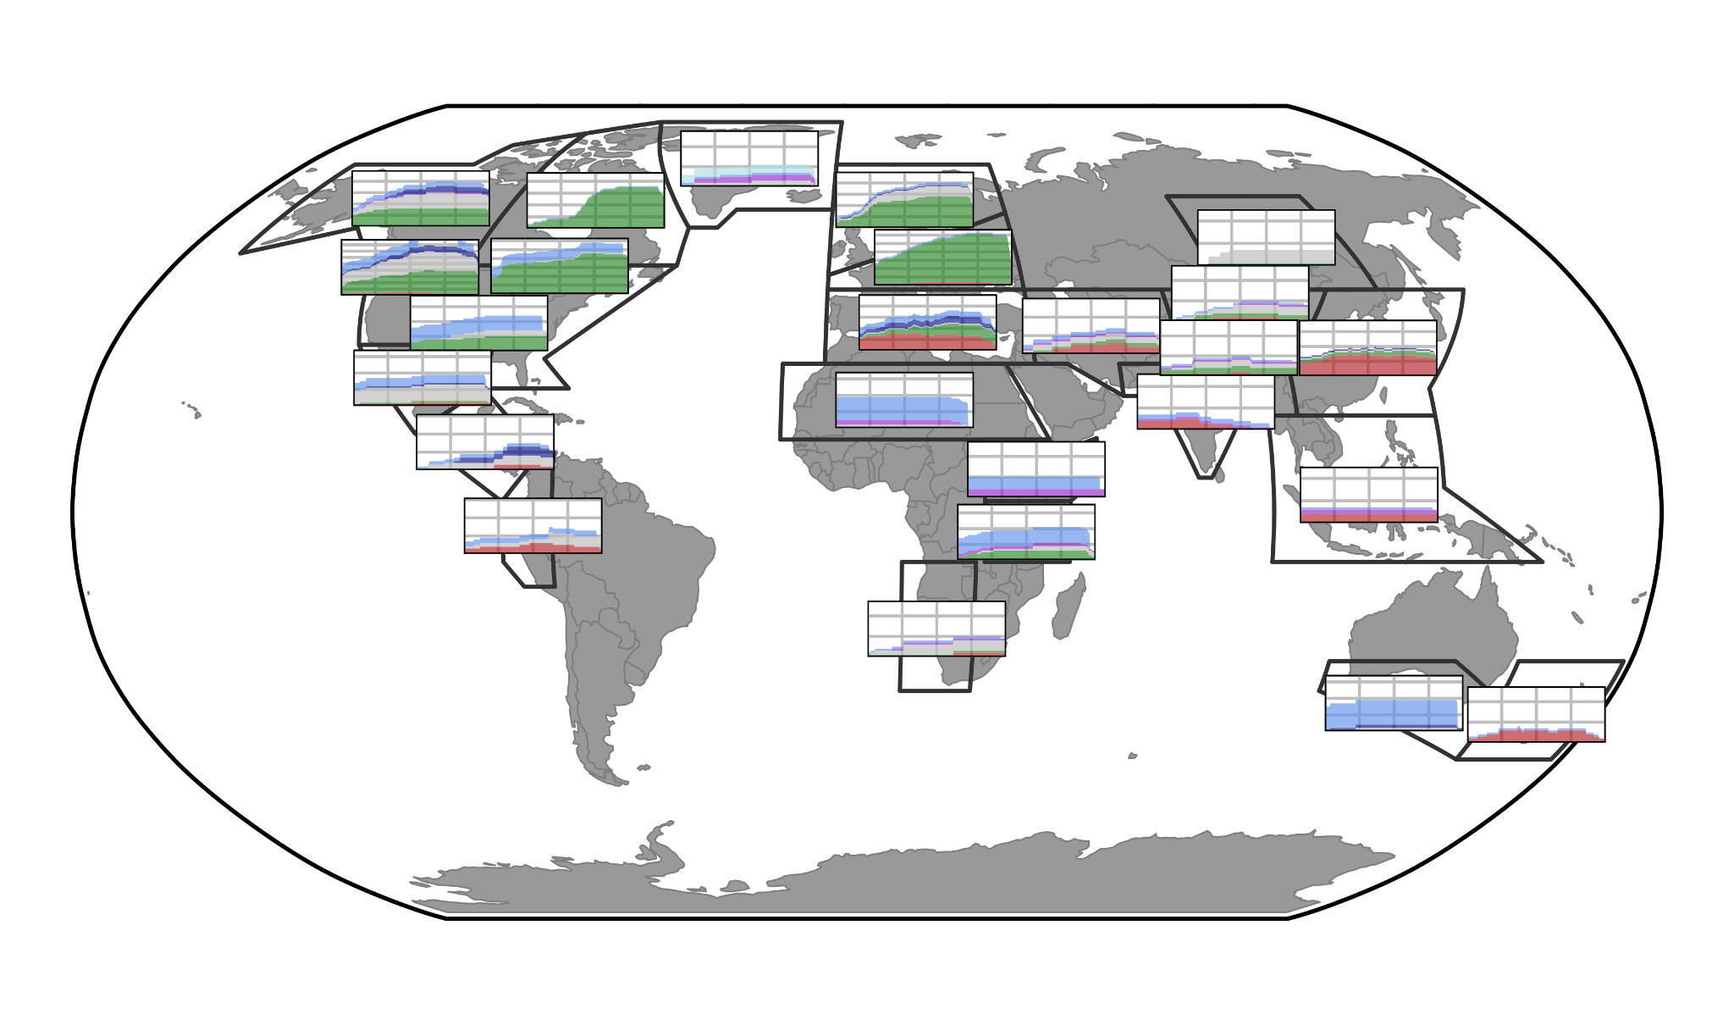
Proxy data by region

Slide 23
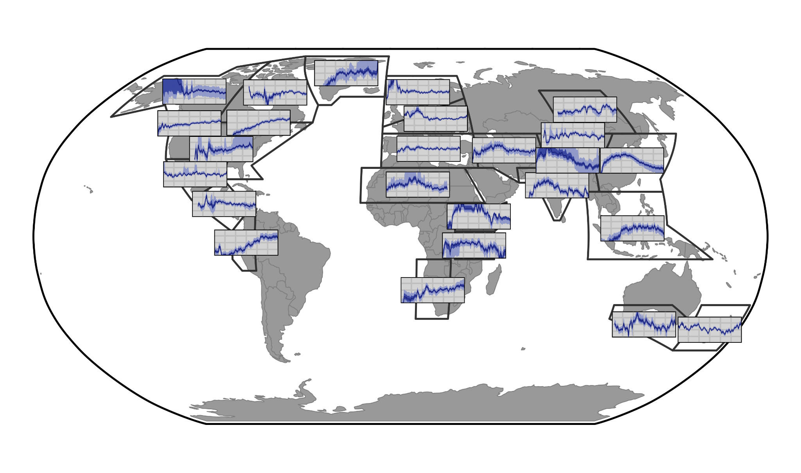
Proxy composites reconstructions

Slide 24
2 Primary Modes of Variability?

Slide 25
abs(PCA1) loading > 0.14. 2 groups

Slide 26
max(abs(PCA1,PCA2)) loading > 0.14. 3 groups

Slide 27
max(abs(PCA1,PCA2,PCA3)) loading > 0.14. 4 groups

Slide 28
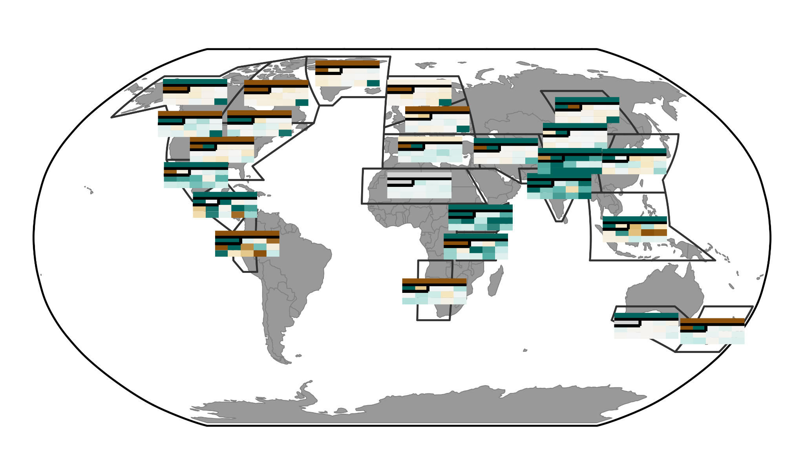
max(abs(PCA1,PCA2)) loading > 0.14. 3 groups

Slide 30
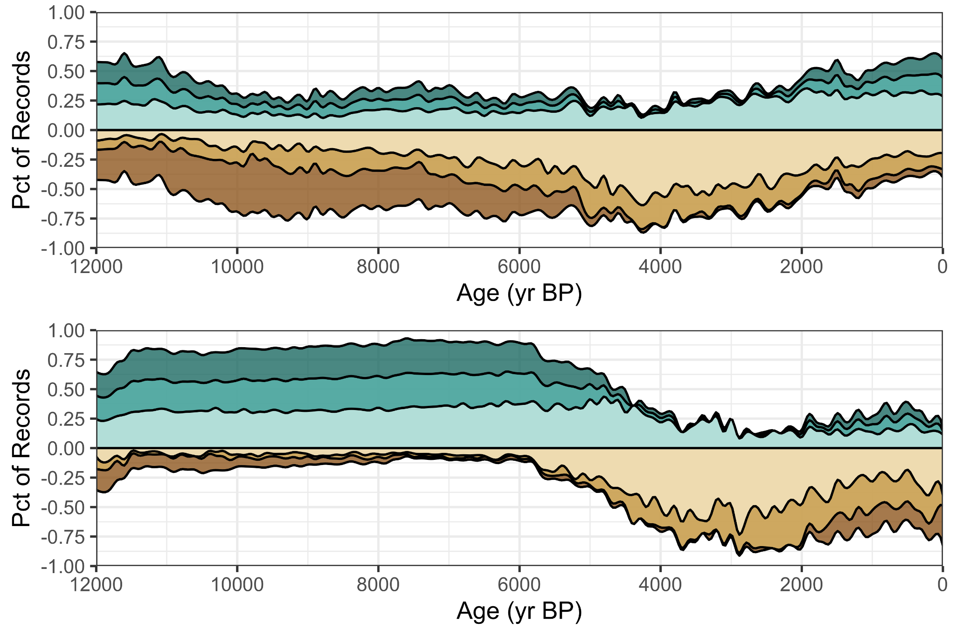
Cody figure

Slide 31
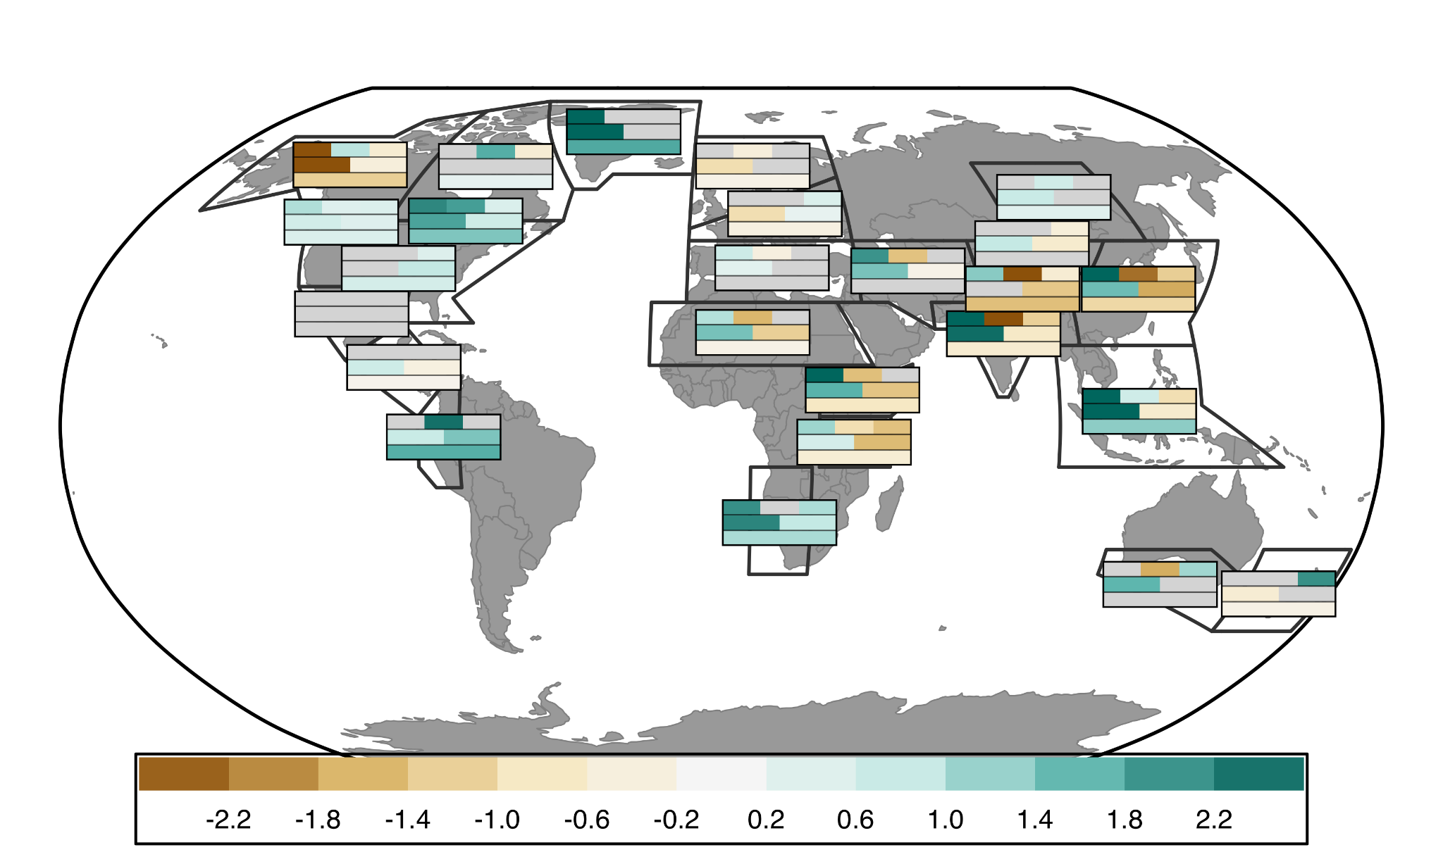
Slope of proxy composites over various time bins (full, half, third)
12-8
8-4
4-0
12-6ka
6-0ka
12-0ka

Slide 32
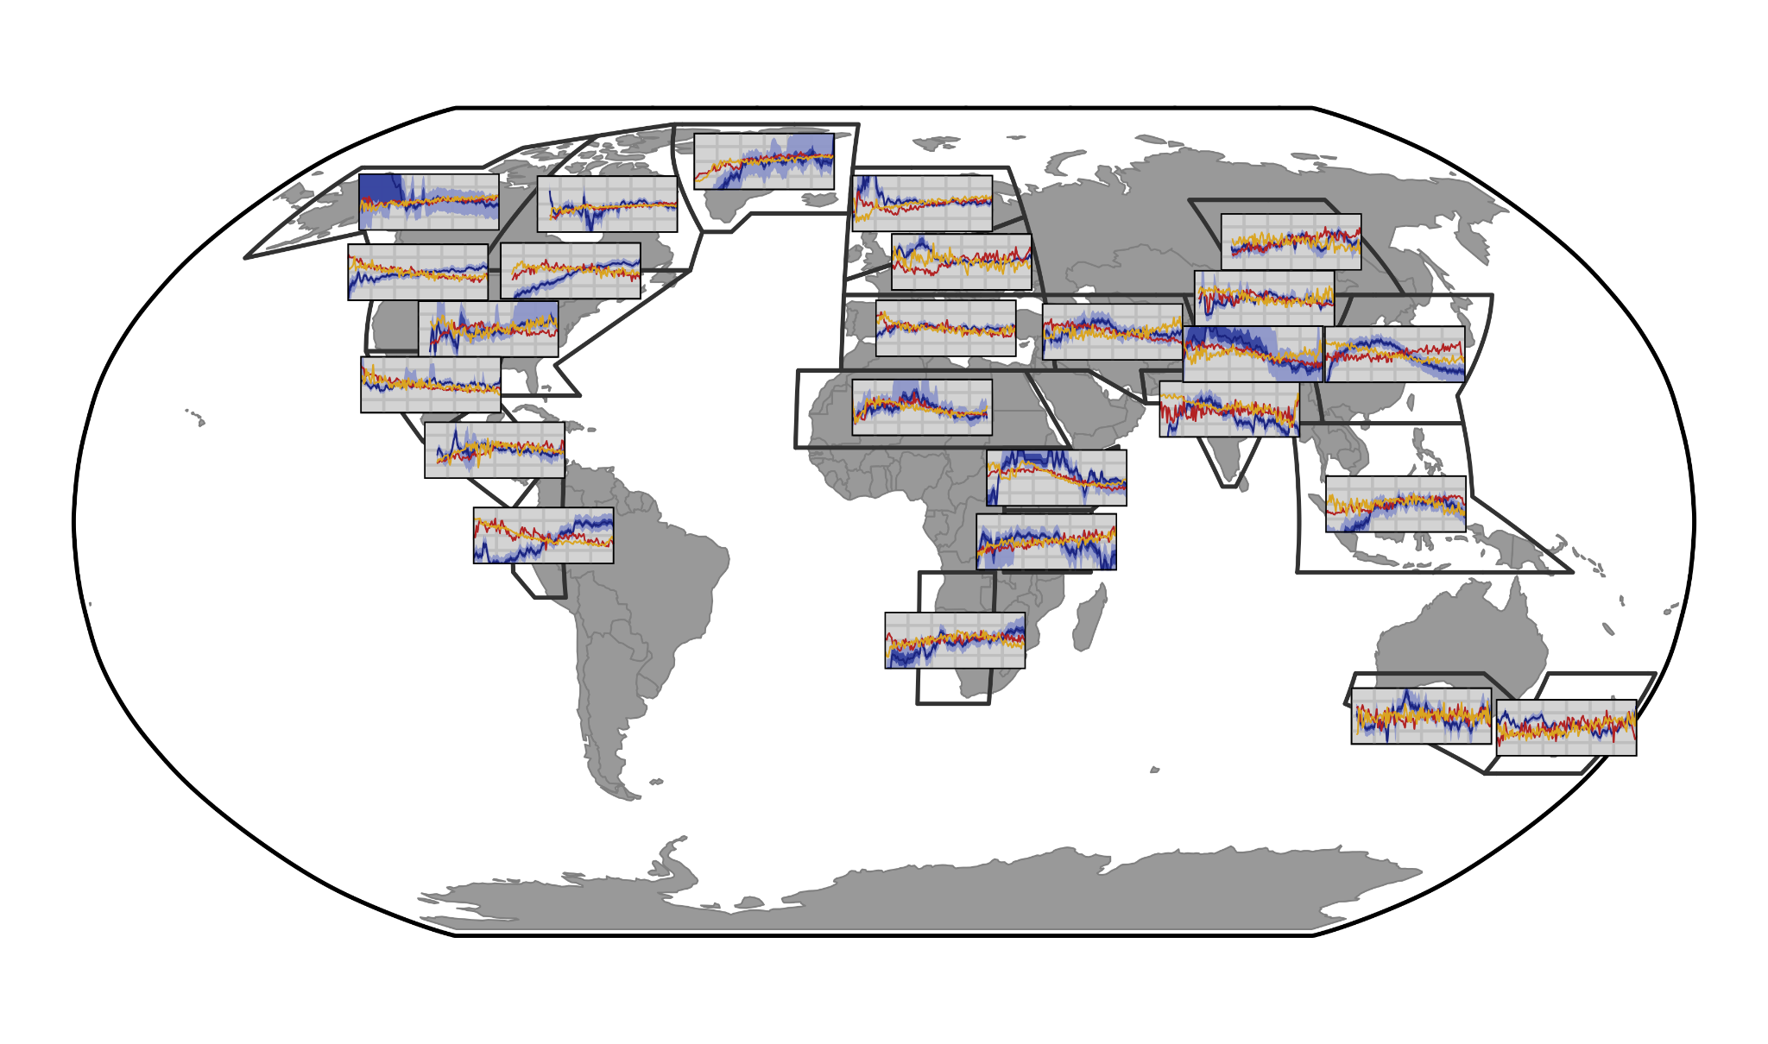
Proxy composites compared to HaCM (yellow) and TraCE (red)

Slide 33
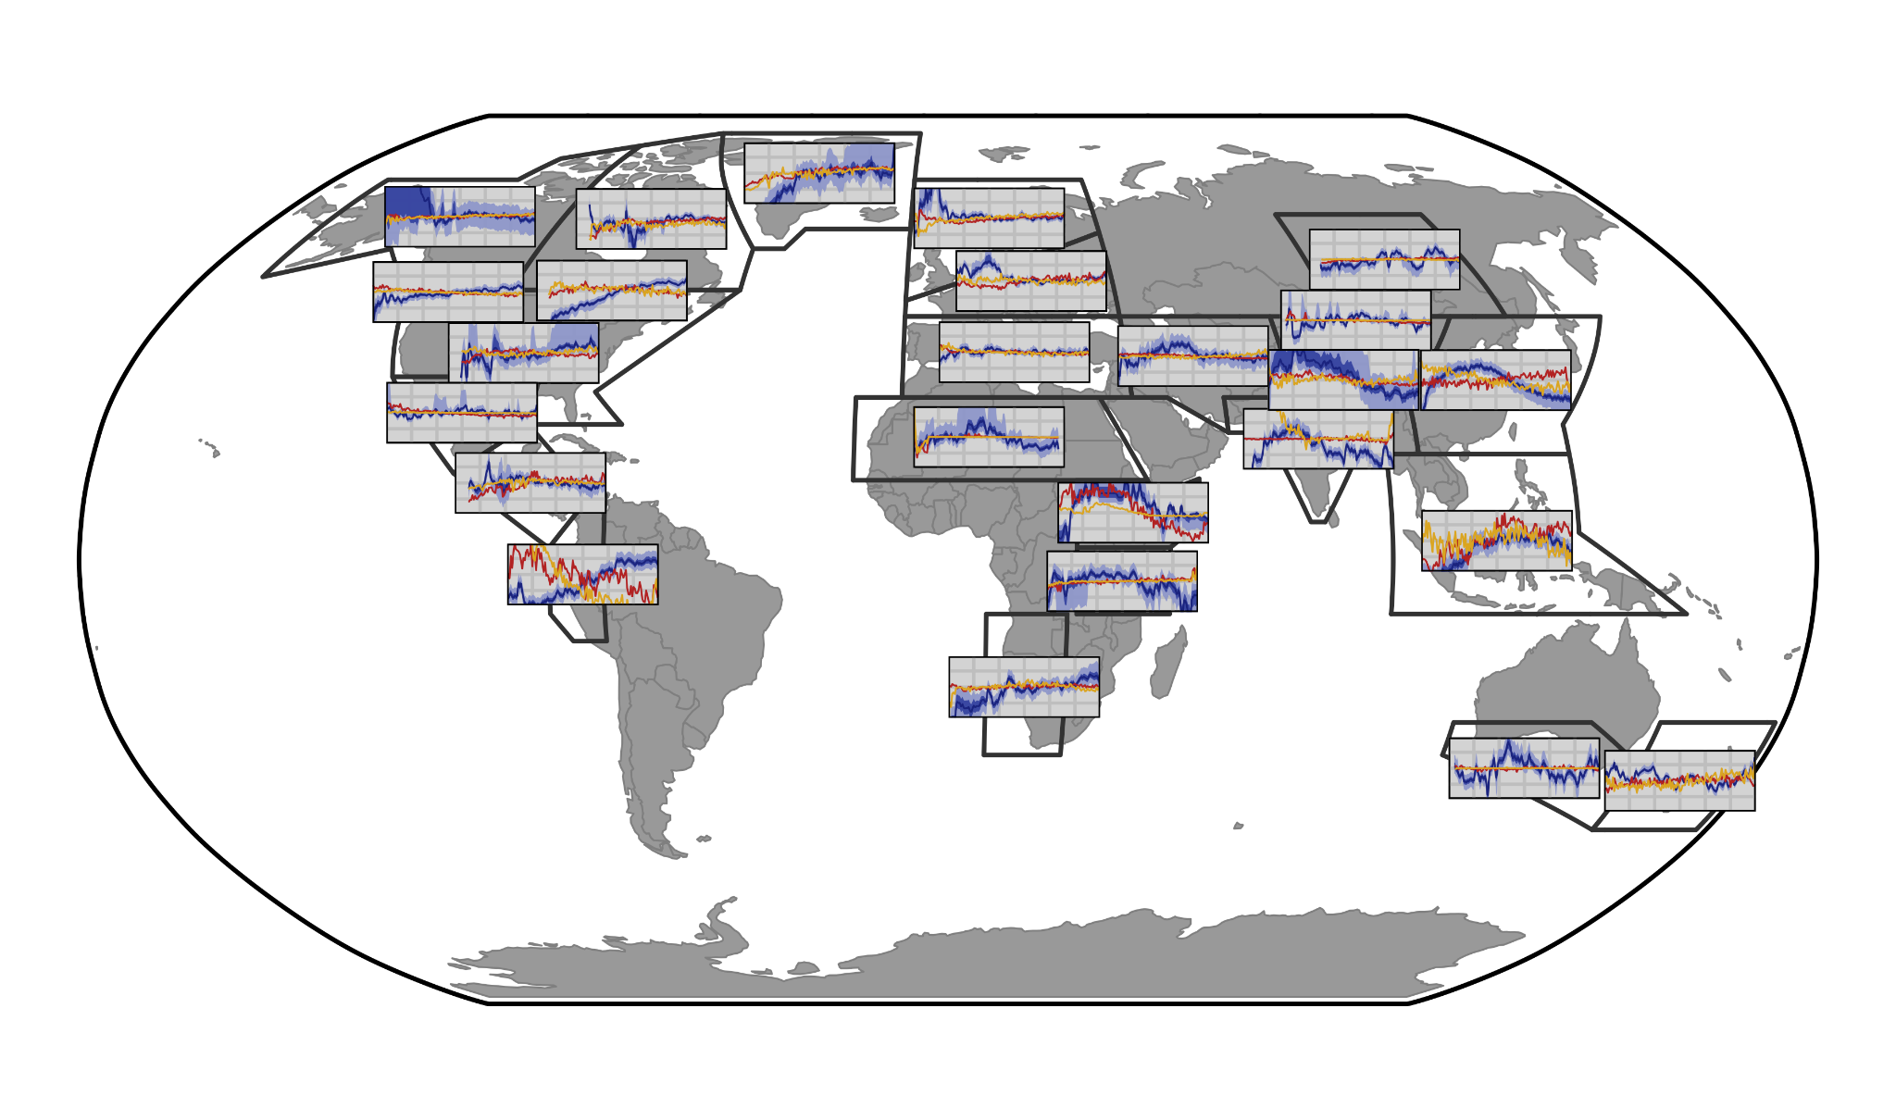
Proxy composites compared to HaCM (yellow) and TraCE (red)

Slide 34
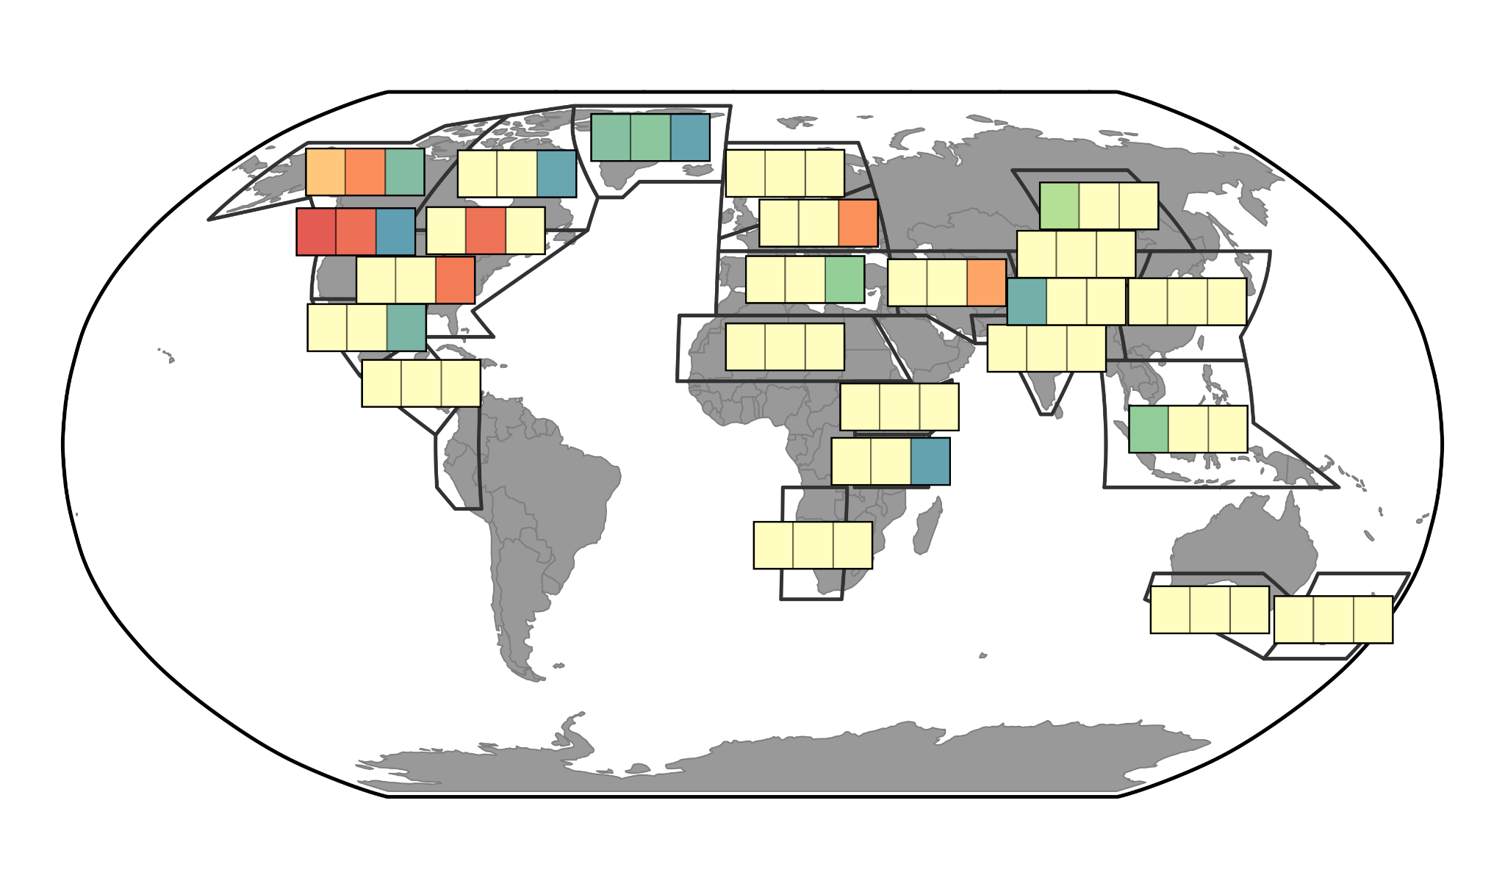
Proxy composites compared to HaCM (yellow) and TraCE (red)
P
T
P
H
H
T

Slide 35
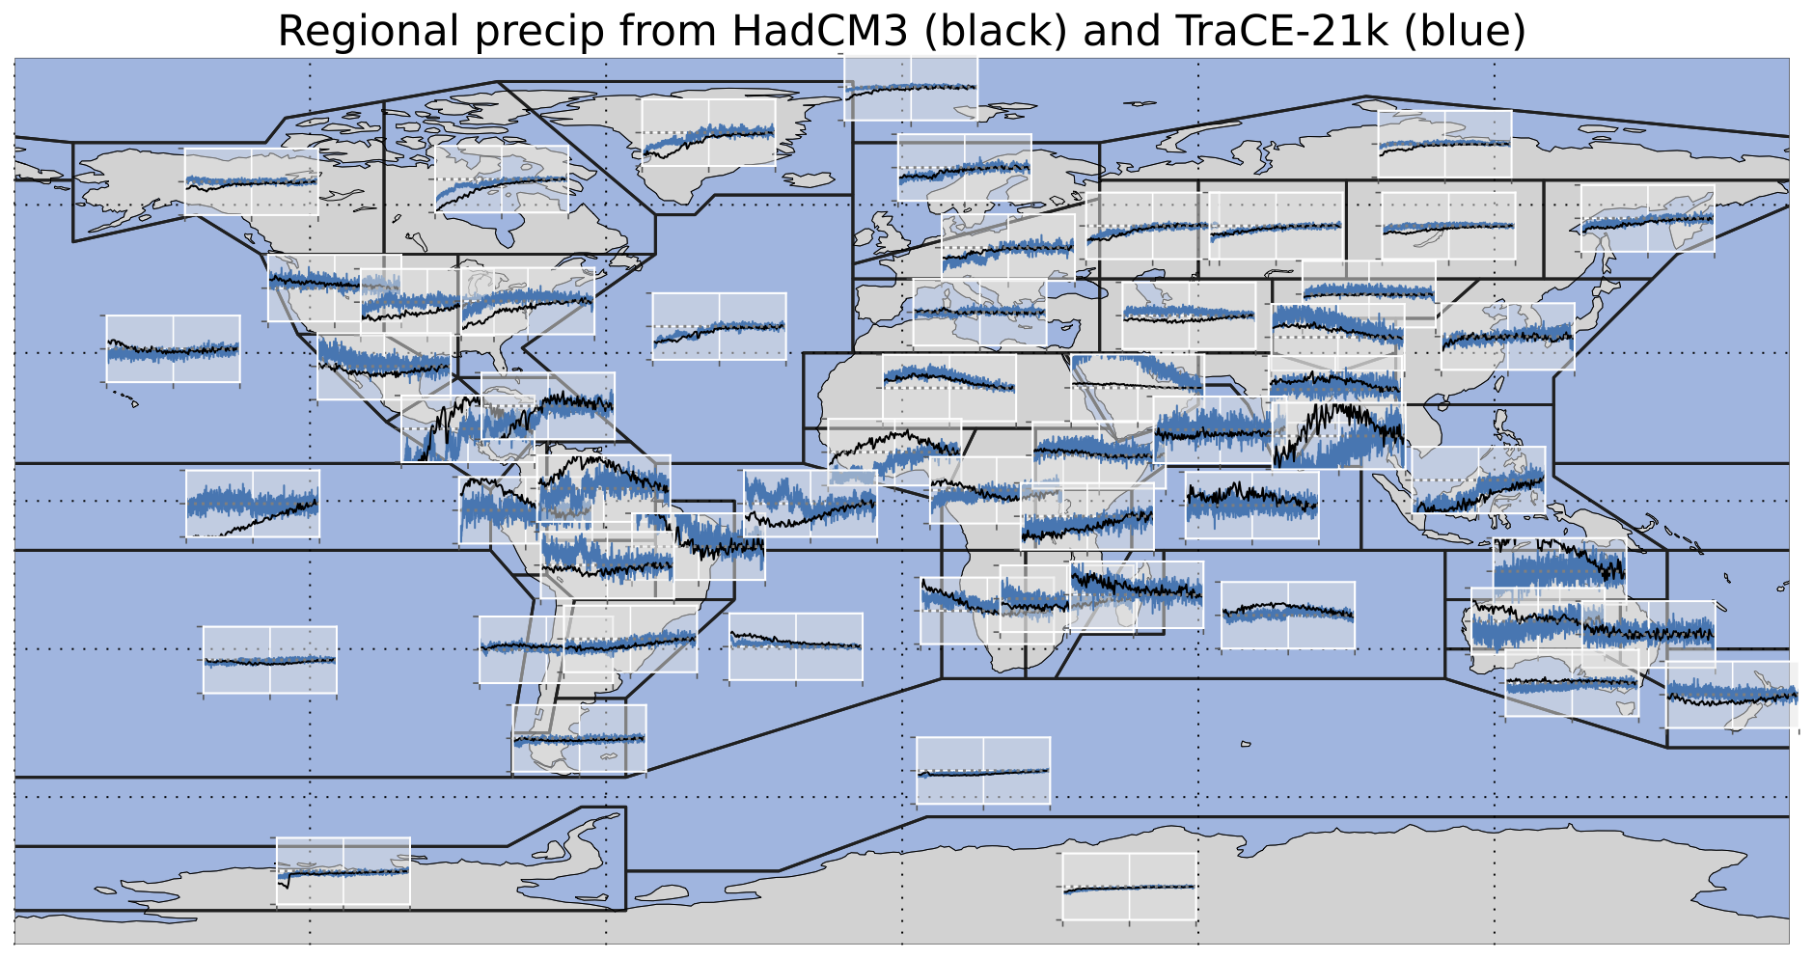

Slide 36
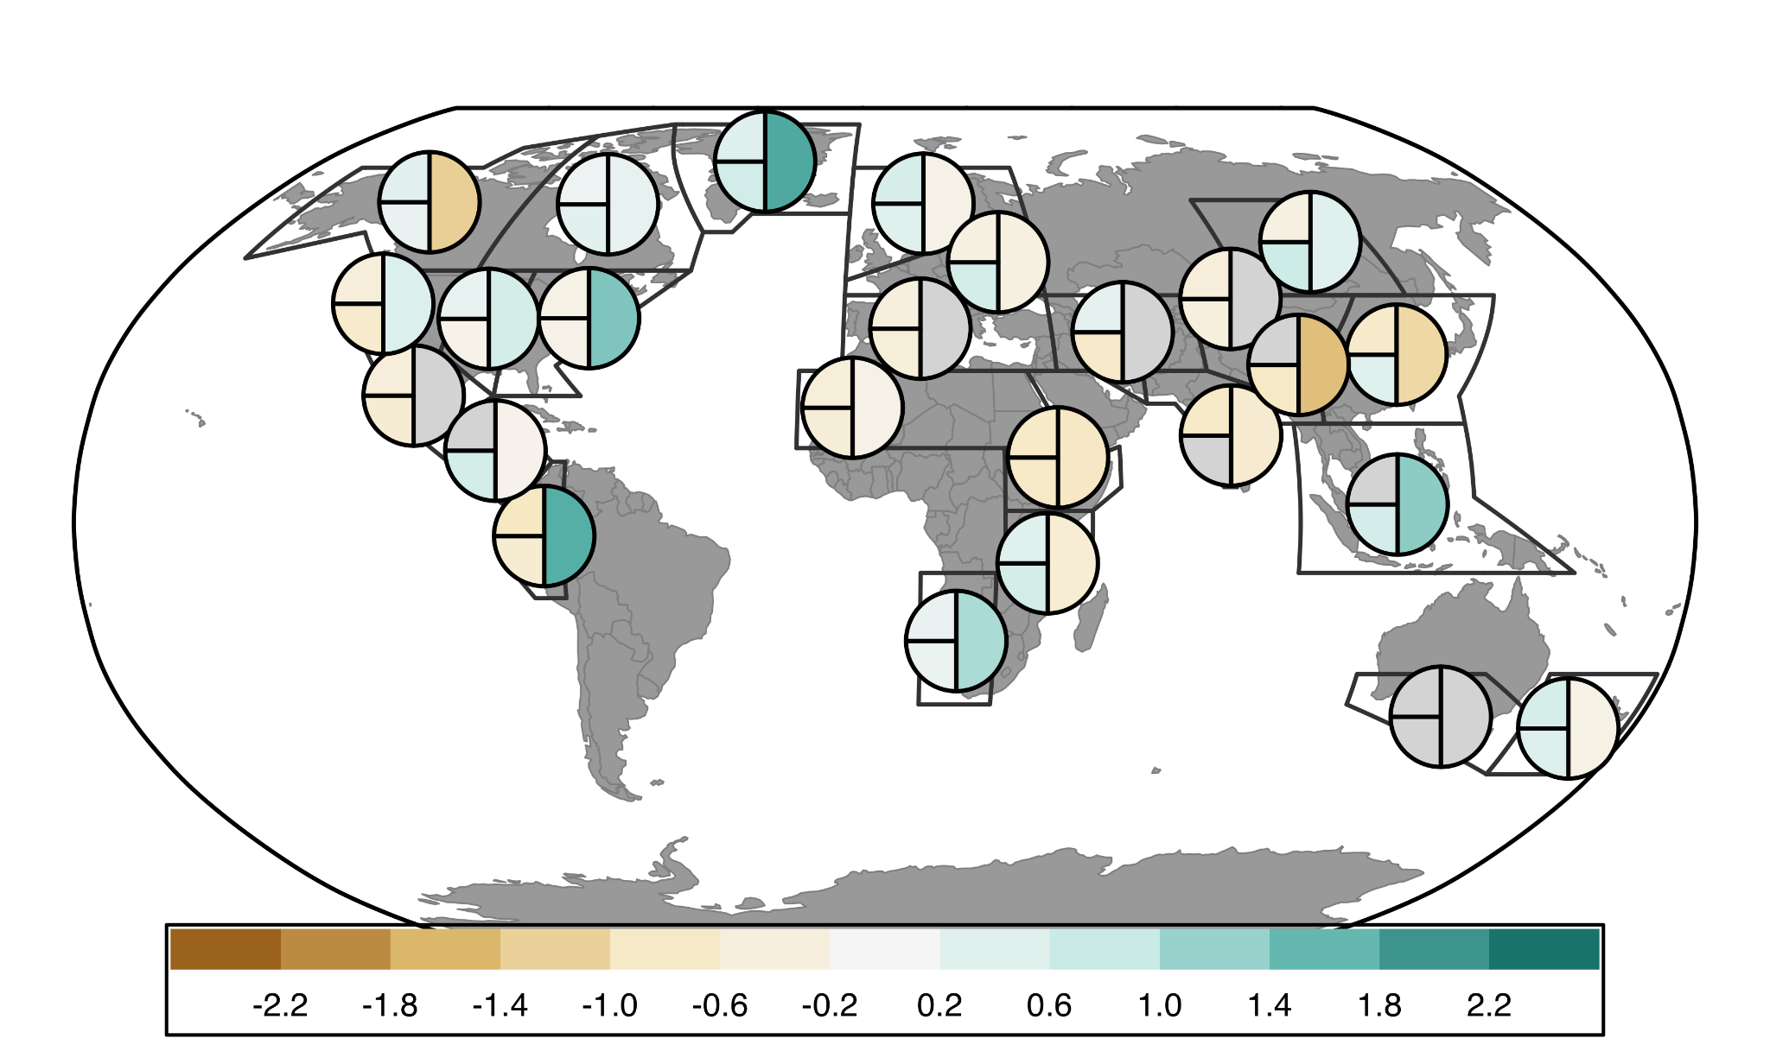
Comparison of Proxy and Model Slopes - FULL (12ka-0ka)
H
P
T

Slide 37
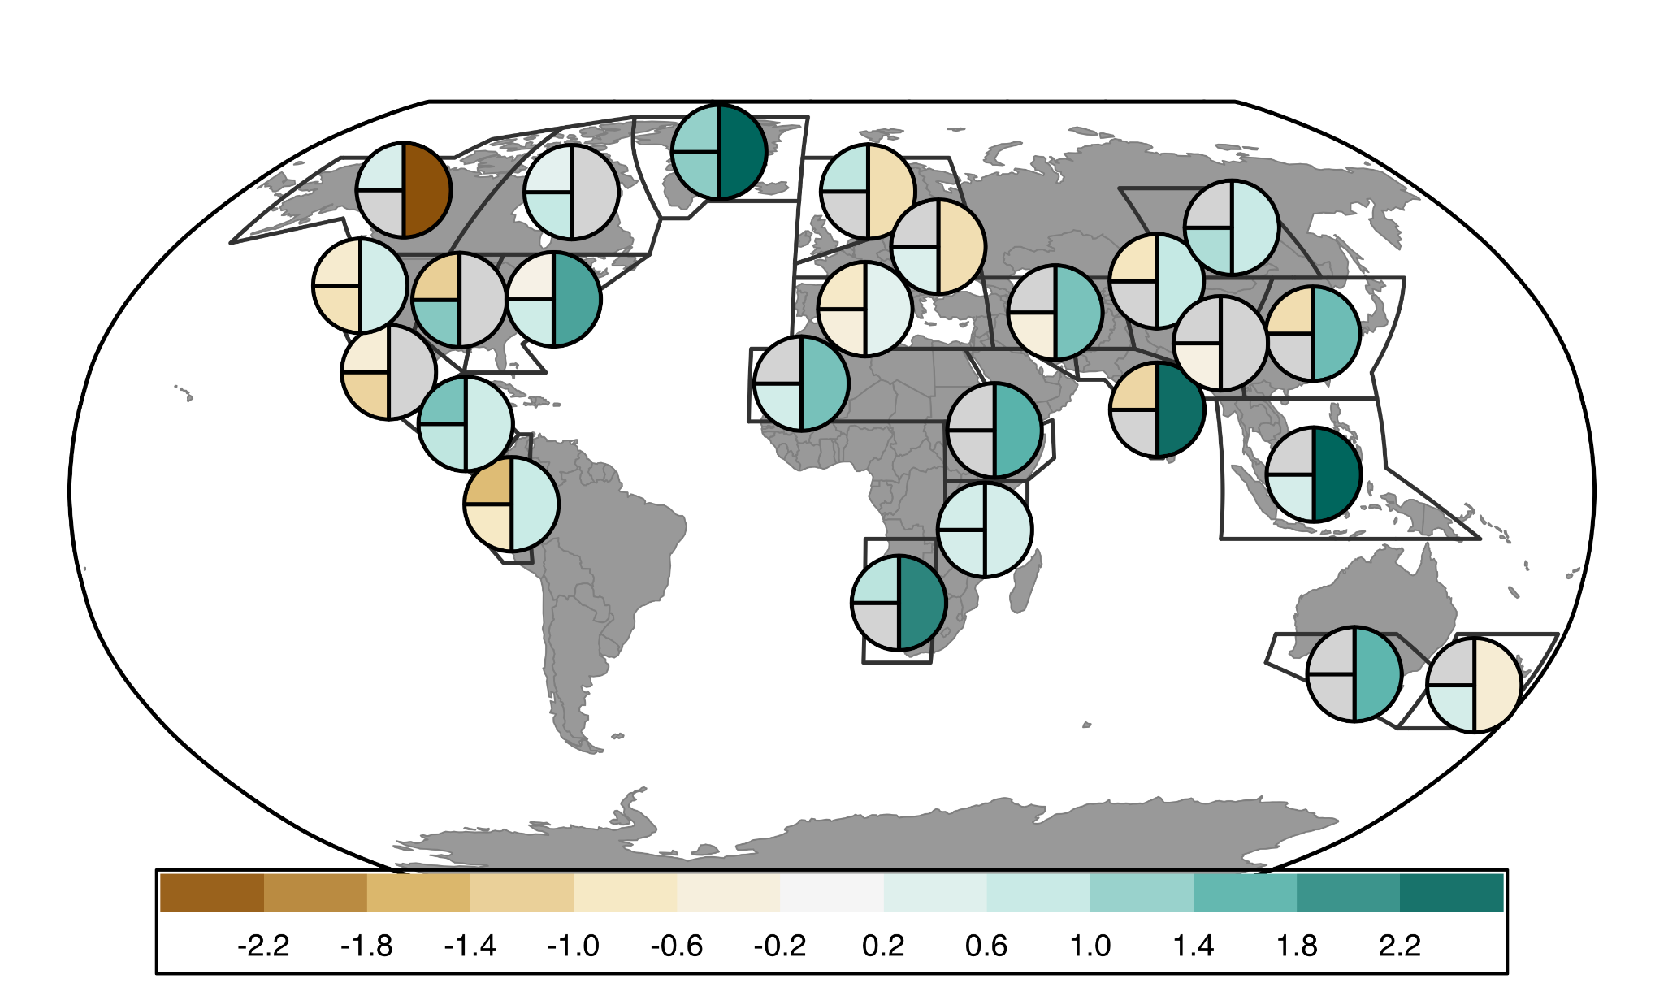
Comparison of Proxy and Model Slopes - EARLY (12ka-6ka)
H
P
T

Slide 38
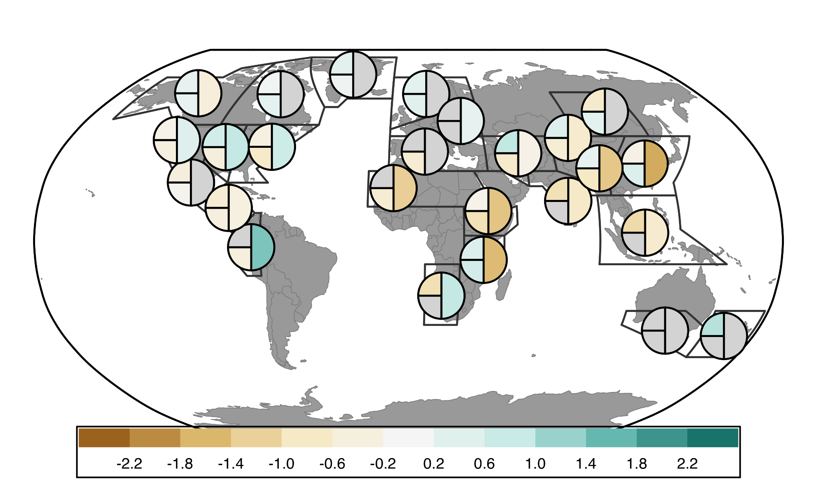
Comparison of Proxy and Model Slopes - LATE (6ka-0ka)
H
P
T

Slide 39
Wetting Stripes (1ka bins)

Slide 40
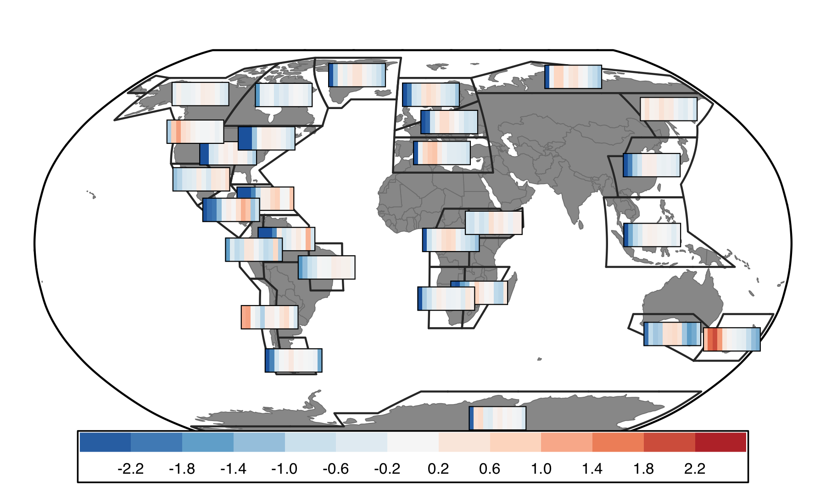
Warming Stripes (1ka bins)

Slide 41
Next Steps:
Decide what I want to say
Proxy-model agreement == model-model agreement
Do regions with agreement reflect more signal (greater magnitude changes
Monsoon signal more widespread in proxy data than models
Similar agreement with late Holocene Temperature?\

Slide 42
Next Steps:
Always more metadata to add/standardize (publication)
Write manuscript
Data Assimilation

Slide 44
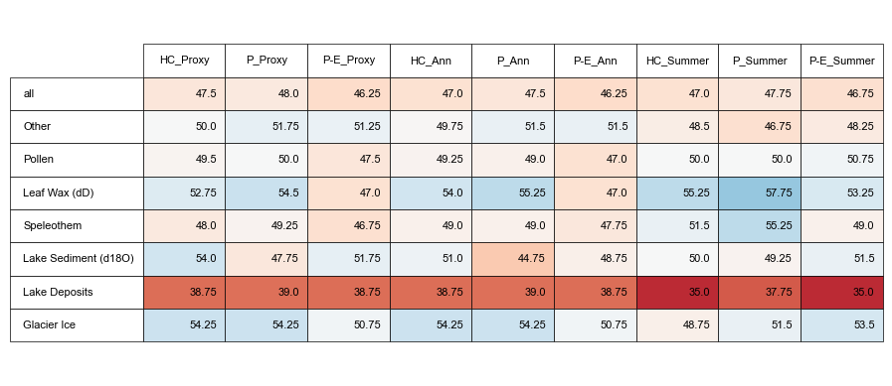
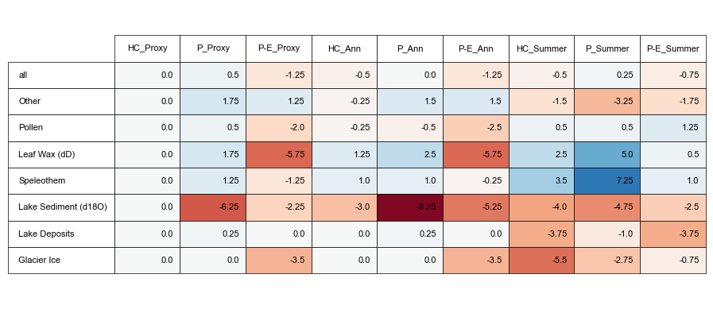
Notes:
Comparisons of how proxies (hydroclimate) compare with model pseudoproxies based on various assumptions about proxy climate interpretation (proxy metadata vs all P vs all P-E) and seasonality (proxy metadata vs assume annual are summer vs assume all are summer)
Top: Absolute %
Bottom: Difference between assumption test and using proxy metadata for both assumptions (1st column)

Slide 45
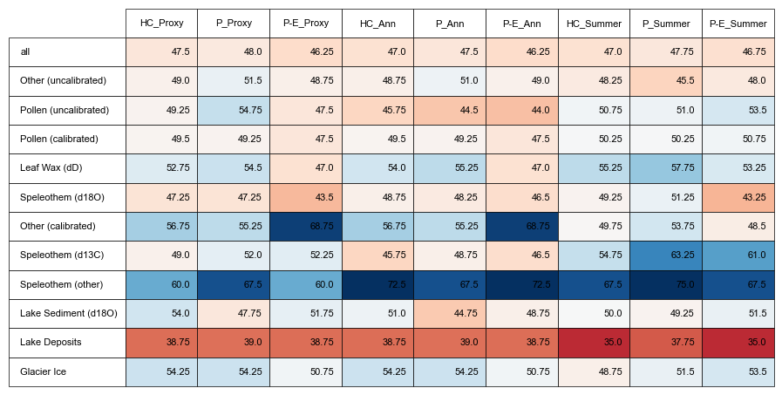

Slide 46
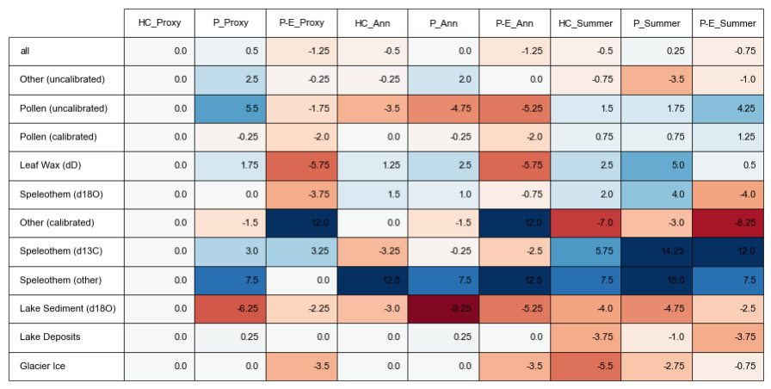

Slide 47
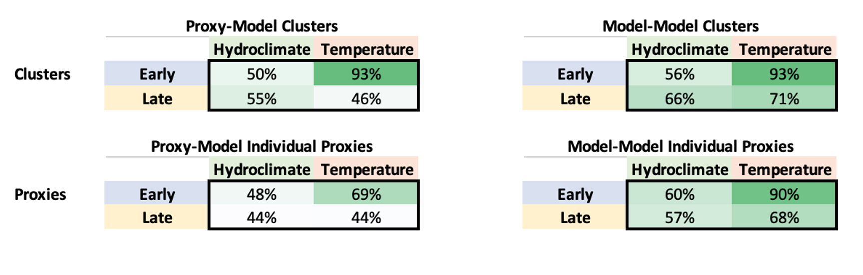

Slide 48

Figure 3: Cluster results
Notes:
R2 values: check from arcgis output

Slide 49

temperature
Notes:
Colors based on HC cluster # so will change to better distinguish neighboring clusters (pacific South America and Antarctica / 2 in Australasia)

